Slide 1

Mobile Application Development, Fall 2021 Advanced State Management Part 3

Slide 2
Today’s Agenda
Working with the Create Screen
Working with the Edit Screen
Extracting Out Form Logic
Finishing Touches

Slide 3


Create Screen
We’re still working in Blog Town!
Index
Show
Create
Edit
Blog List
+
Blog List
Blog List
Blog List
Blog Title
Blog Title
My blog post today is going to be about my favorite things. Rain drops on roses and whiskers on Kittens!
Enter Title:
Enter New Title:
Blog Title
Blog Title
Enter Content:
Enter New Content:
Blog Title
Save
Save

Slide 4
Create Screen
Blog Post Provider
blogPost: []
We’re doing this with Providers and the Context system
Which makes it easy to store data in one central place
And then provide it to *any* component that needs it.
Regardless of how nested it is in our application.
React Navigation Stack Navigator
IndexScreen
ShowScreen
CreateScreen
EditScreen
BlogList

Slide 5
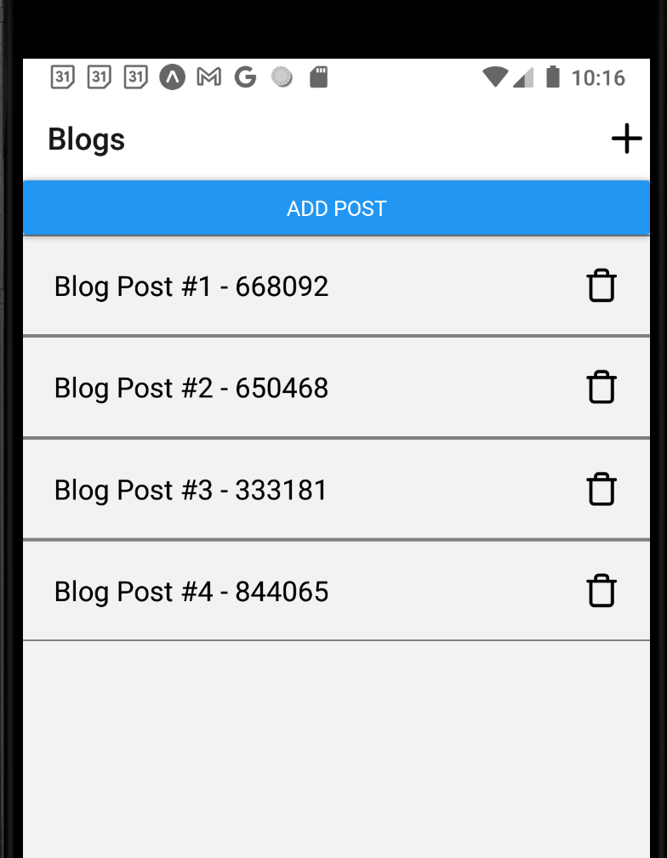
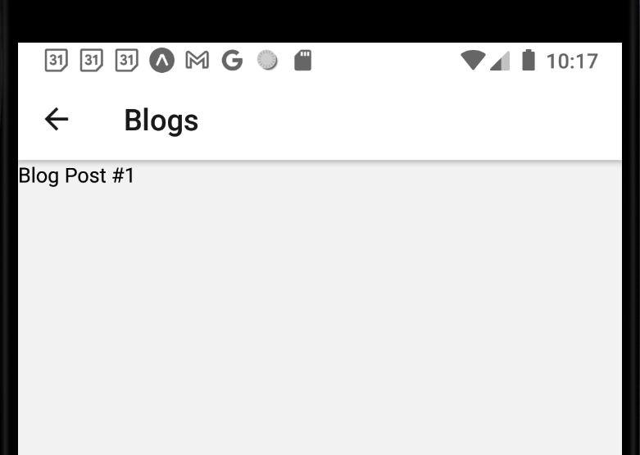
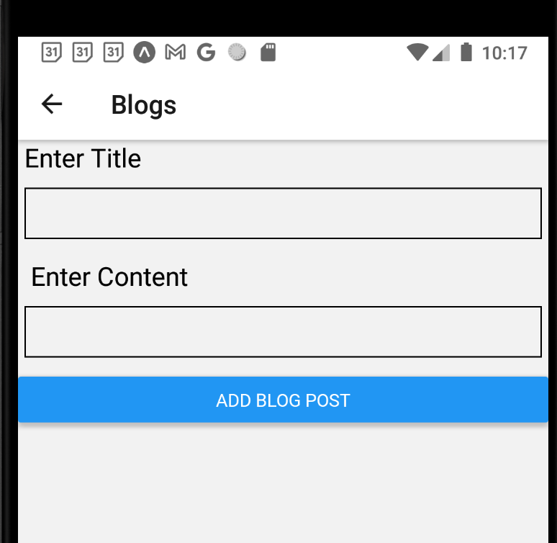
Create Screen
This is what our app looks like so far.
ShowScreen.js
CreateScreen.js
IndexScreen.js

Slide 6
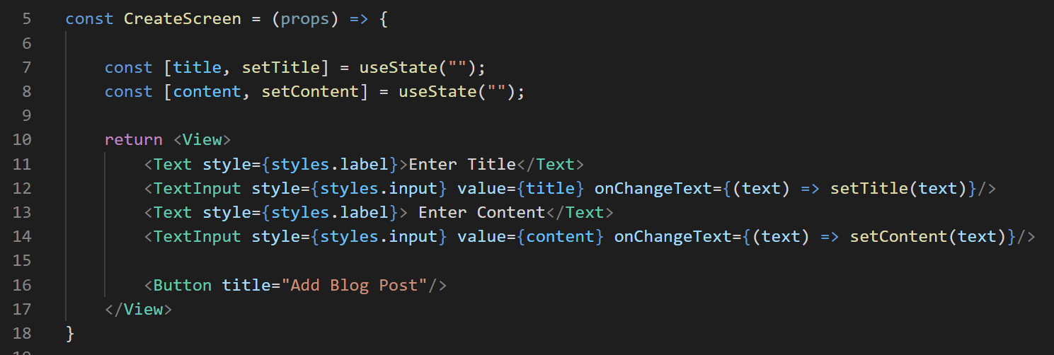

Create Screen
And this is the last thing we were working on.
However, the “Add Blog Post” button doesn’t do anything.
It doesn’t even have onPress defined!
CreateScreen.js

Slide 7
Create Screen
Let’s get it so that we can actually Add a Blog Post!
This means our BlogContext needs to now be able to create new Blog posts based on the content of these fields.
CreateScreen.js

Slide 8
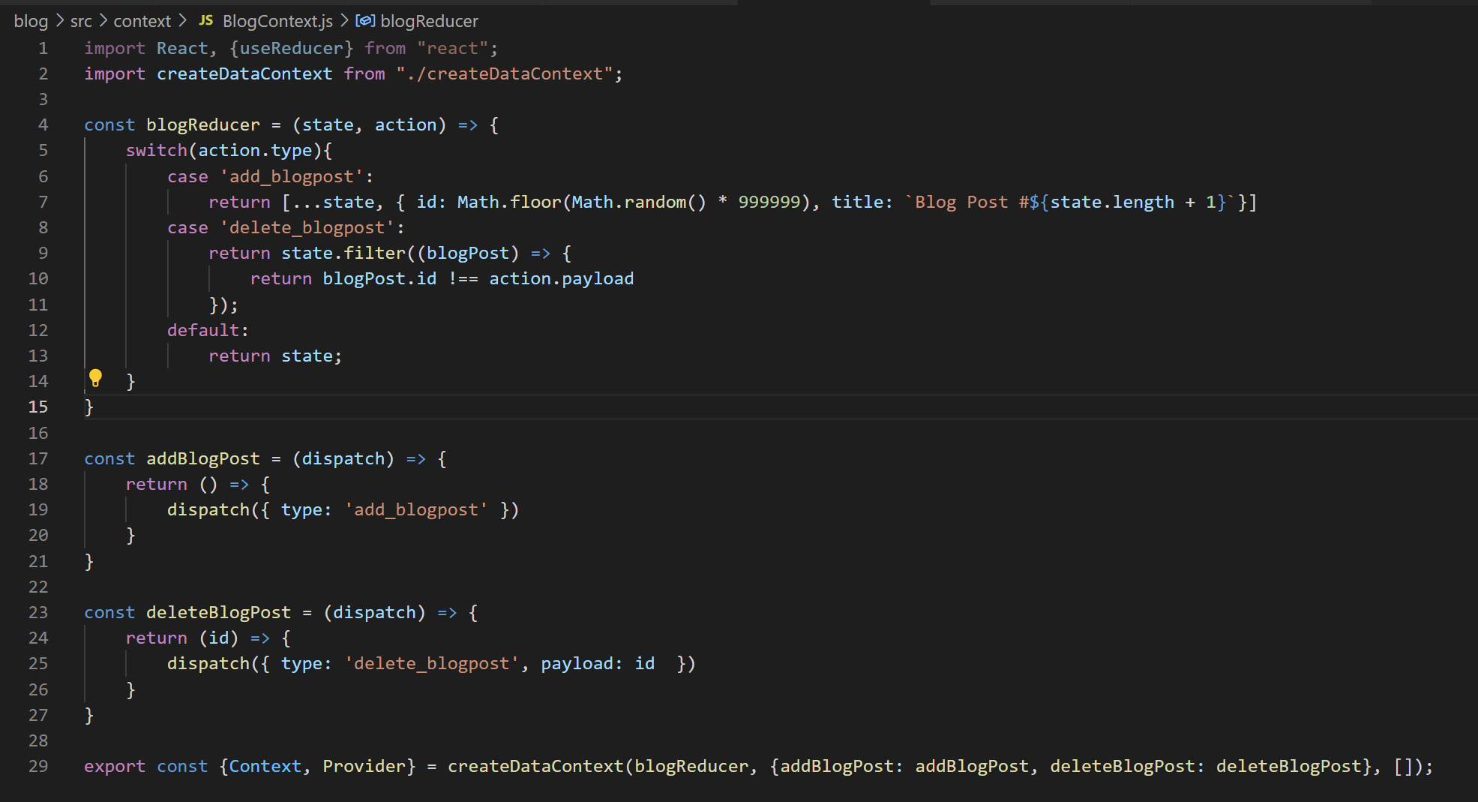


Create Screen
BlogContext.js does, indeed, have a addBlogpost() method already.
But right now it only adds random blog posts.
What do we need to do to make it less random here?
BlogContext.js

Slide 9
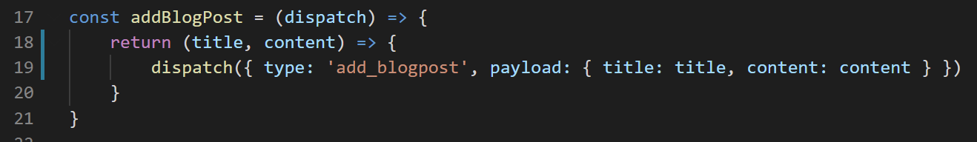
Create Screen
BlogContext.js
Maybe something like this!
We have our inner function now take in two pieces of data
One to represent the ‘title’ of the post
A second to represent the ‘content’
i.e., the things that we’ll be getting from those form fields…
And then when we call dispatch, we’ll pass those along in a payload object!

Slide 10
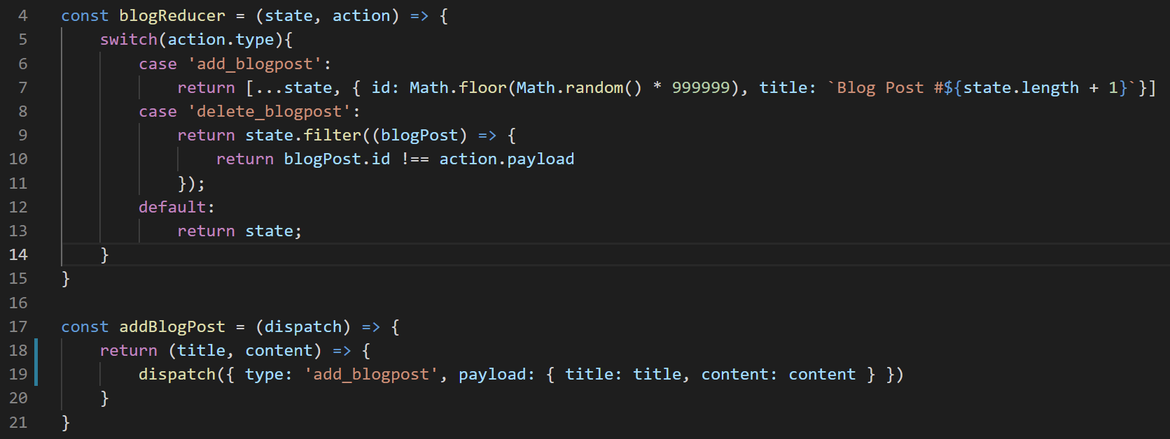
Create Screen
Of course, just including them in dispatch isn’t enough!
How do we update our reducer to leverage them?
BlogContext.js

Slide 11
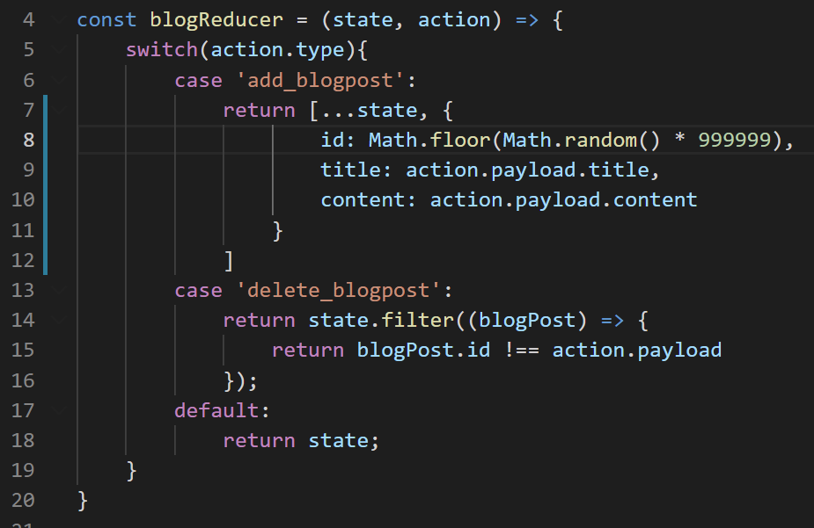
Create Screen
Maybe something like this?
We are updating the “add” case…
We can keep our id logic unchanged…
But the title of the new blog post is whatever was stored in the payload.
And same with content!
BlogContext.js

Slide 12
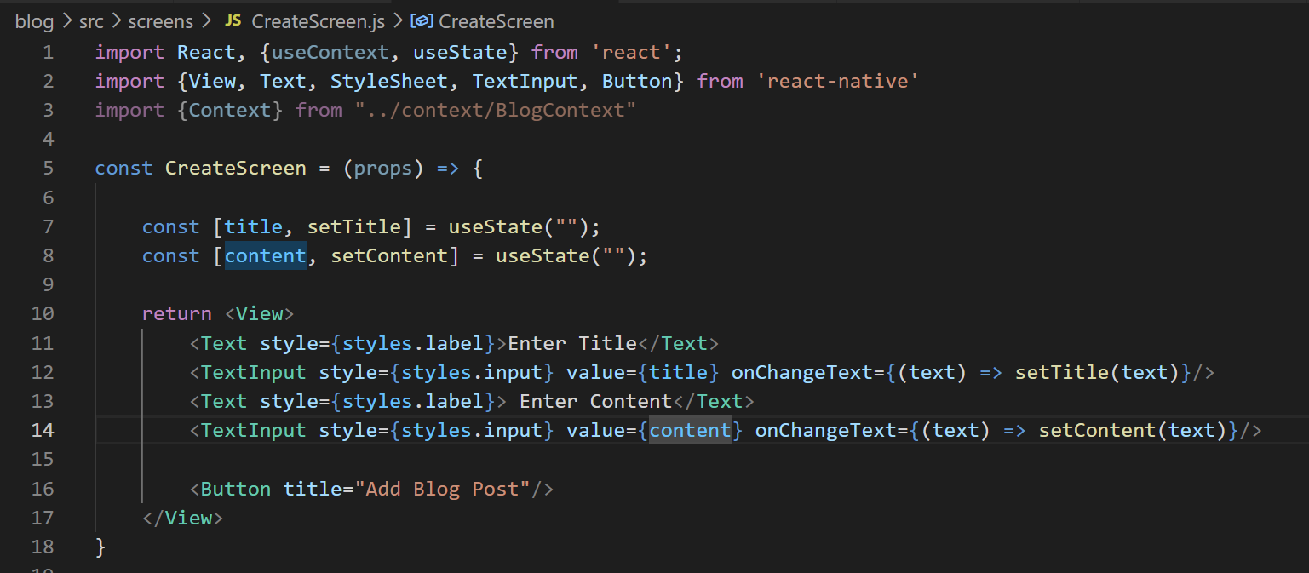

Create Screen
Now we need to hook it up to actually pressing the button in CreateScreen.
For sure, that means we’ll need to give out Button an onPress event.
But what else do we need to do here?
CreateScreen.js

Slide 13
Create Screen
Pushing the button is going to ultimately be sending data to the BlogContext provider.
Right? Pushing the button adds a new blog post.
That’s new data.
And all blog post data lives in the provider.
Do you remember how we get access to the provider?
Hint: We’re already importing the Context object.
CreateScreen.js

Slide 14
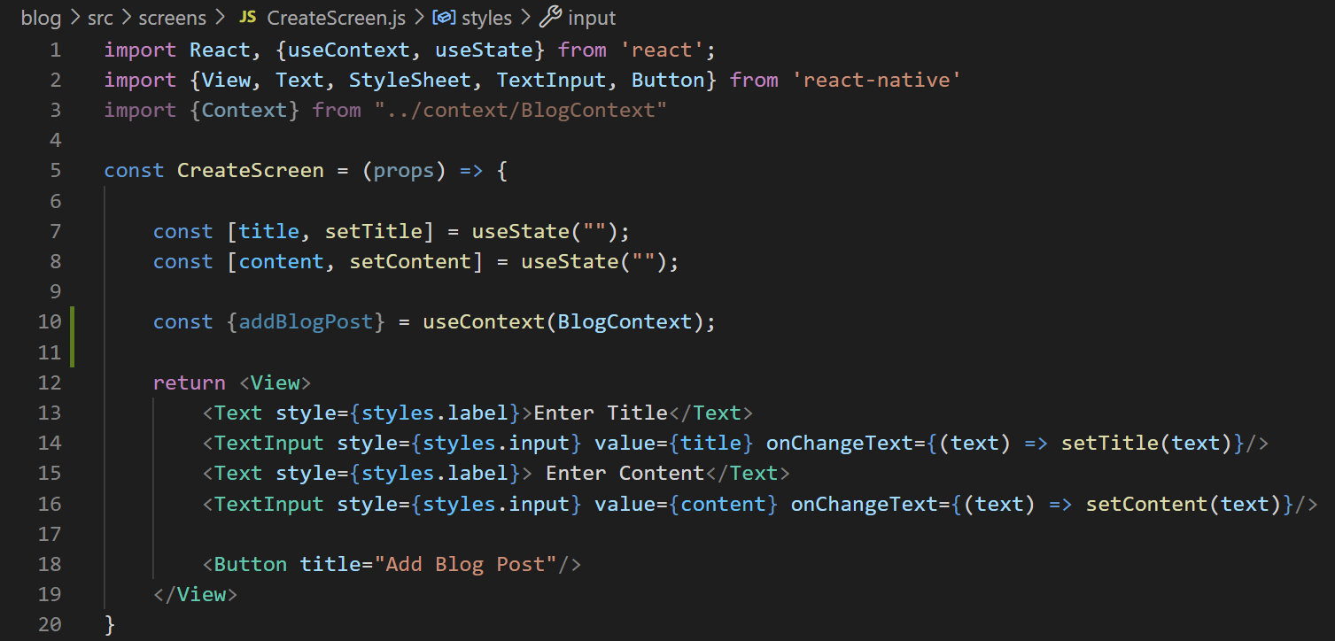

Create Screen
We use the useContext() hook.
We pass in a Context object.
And we get back the values stored in it’s Provider’s “value” prop.
Context
CreateScreen.js
BlogContext.js

Slide 15
Create Screen
For what we have set up right now…
That’s going to be all of our helper functions.
e.g., addBlogPost and deleteBlogPost.
It will also be “state” variable that is the list of blog posts.
Context
CreateScreen.js
BlogContext.js

Slide 16
Create Screen
We could access *all* of those things if we wanted.
But since this screen is only going to be concerned with adding a blog post…
We can get away with only destructuring addBlogPost.
Context
CreateScreen.js
BlogContext.js

Slide 17
Create Screen
That’s the new part that we are still just learning about!
Now that we have it, how do we make it so that pushing a button adds a blog post?
Context
CreateScreen.js

Slide 18
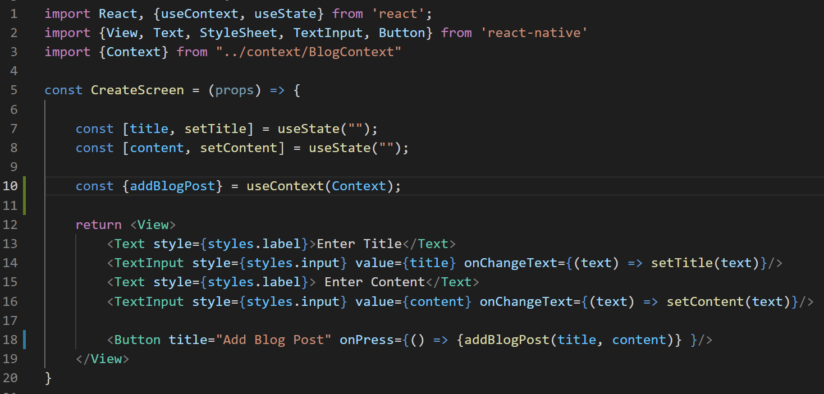

Create Screen
We give the button the onPress event!
Where clicking it invokes the function we got from the provider!
And we pass in the title and content.
Which themselves are simply whatever the user typed into the search boxes.
CreateScreen.js

Slide 19
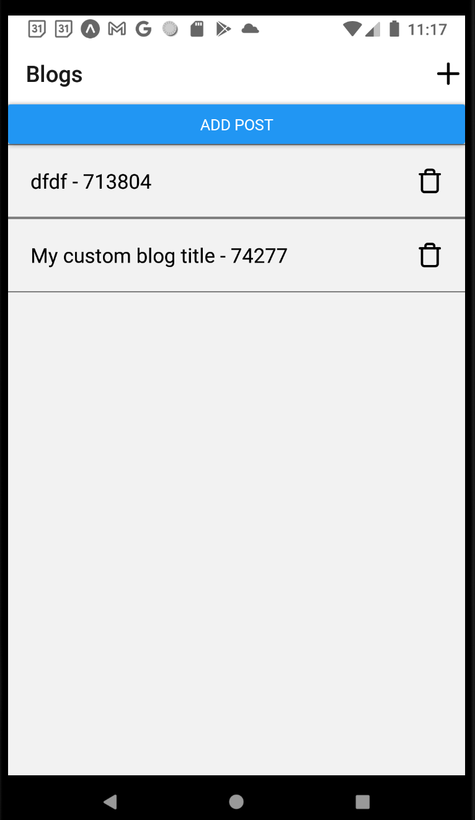
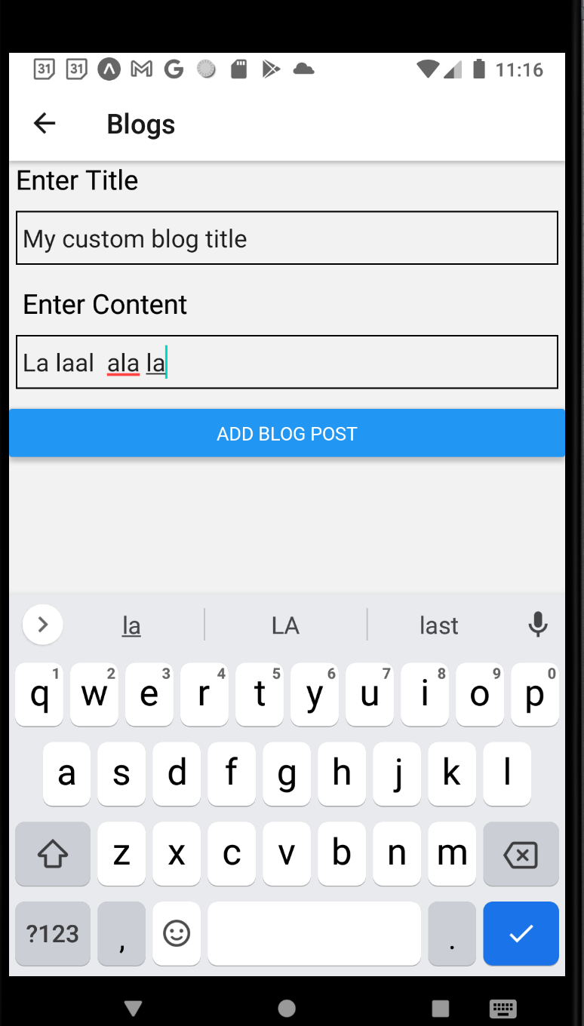
Create Screen
Now here’s the thing…
We can now type stuff in and push the button…
And it DOES in fact update our list of blog posts!

Slide 20

Create Screen
The thing is, that it doesn’t take us back to the list automatically.
You have to click the arrow to go back.
And it might be hard to envision that being a problem…
But trust me, when you click the “Add Blog Post” button, you want *some* confirmation that it worked.
And navigating back to the list is reasonable/expected!

Slide 21
Create Screen
We’ve dealt with navigation many times!
There are easy ways to do it…
But there’s also a slightly more complicated way.
Let’s see the easy way real quick…
Then let’s do it the more complicated way!

Slide 22
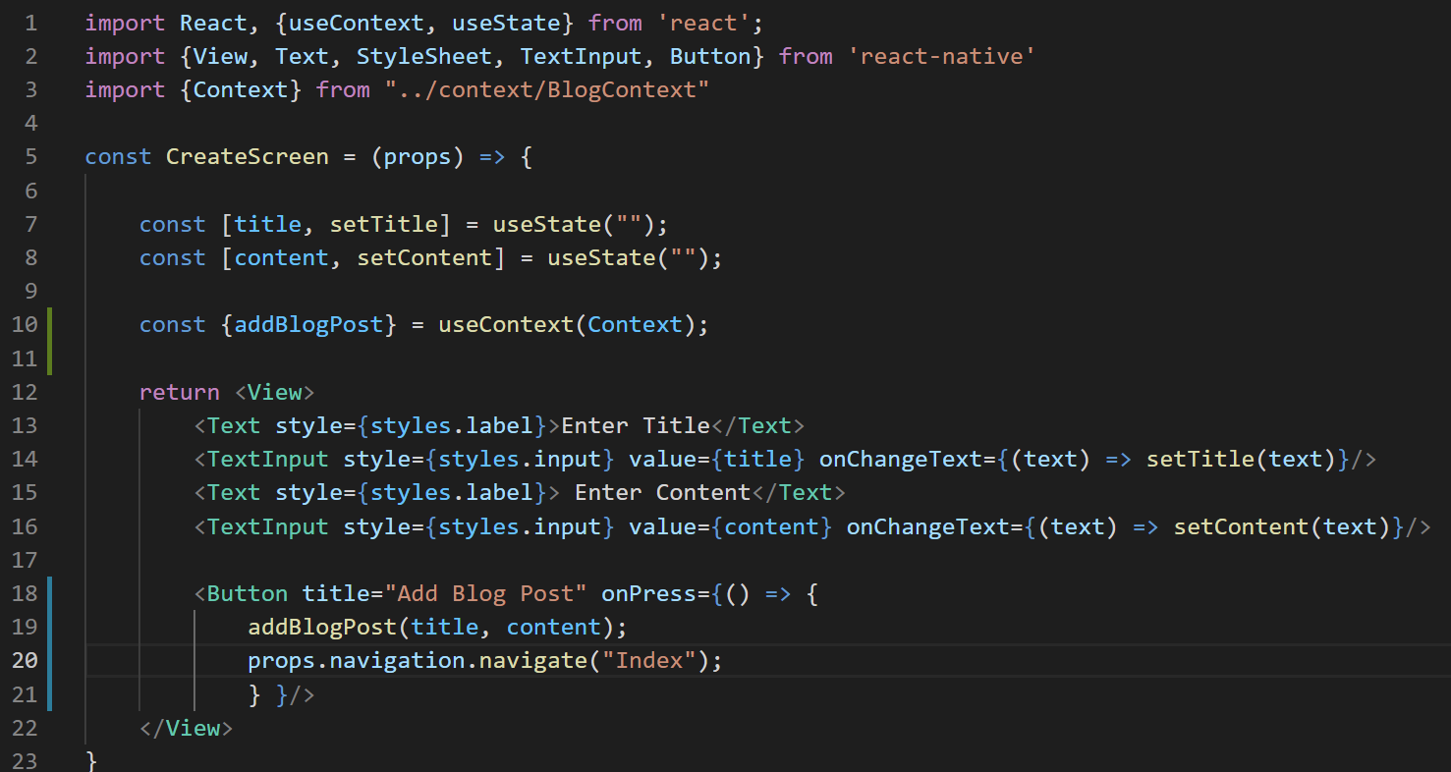
Create Screen
We’ve done the easy way lots.
We make sure we are receiving the navigation object through props.
And then in onPress, we use its navigate function to navigate to Index after adding the blog post.
CreateScreen.js

Slide 23

Create Screen
And this works! This would get the job done!
However, maybe not the best thing to do in this case…
Any thought as to why?
CreateScreen.js

Slide 24
Create Screen
Here’s one reason…
Right now we navigate after addBlogPost.
addBlogPost is pretty immediate! It runs pretty instantaneously.
So when we navigate back to the index, everything will be reflected.
CreateScreen.js

Slide 25
Create Screen
BUT!
If addBlogPost, instead of just adding to an internal list…
Was making a network request, or something else that could take some time…
Then we wouldn’t want to navigate back until it was finished with its work.
CreateScreen.js

Slide 26
Create Screen
So the problem:
We don’t want props.navigation.navigate() to happen until addBlogPost is for sure done.
The solution:
Set up addBlogPost with a “callback function”
i.e., a function it will call when it finishes its work!
CreateScreen.js

Slide 27
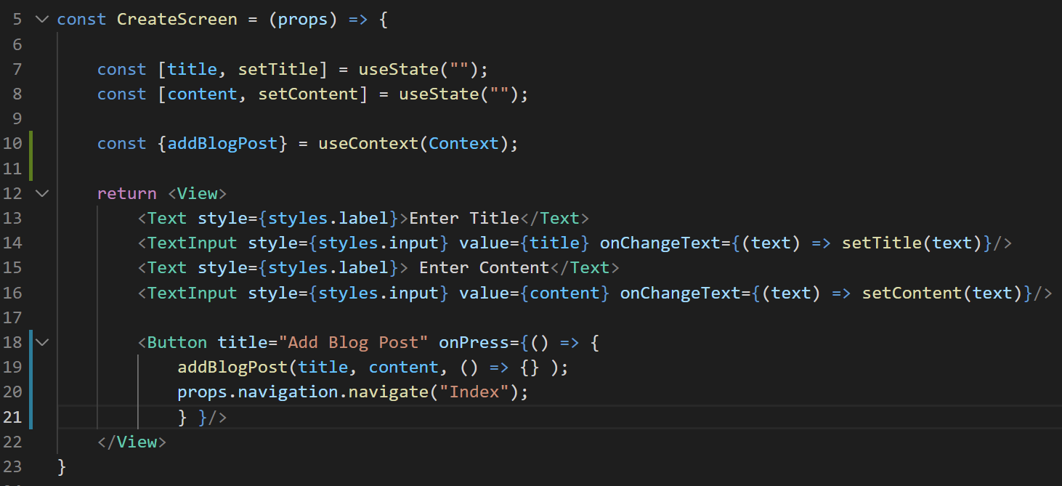
Create Screen
We’ll give it a callback function as a third argument.
Currently empty. Any thoughts as to what should go in here?
CreateScreen.js

Slide 28
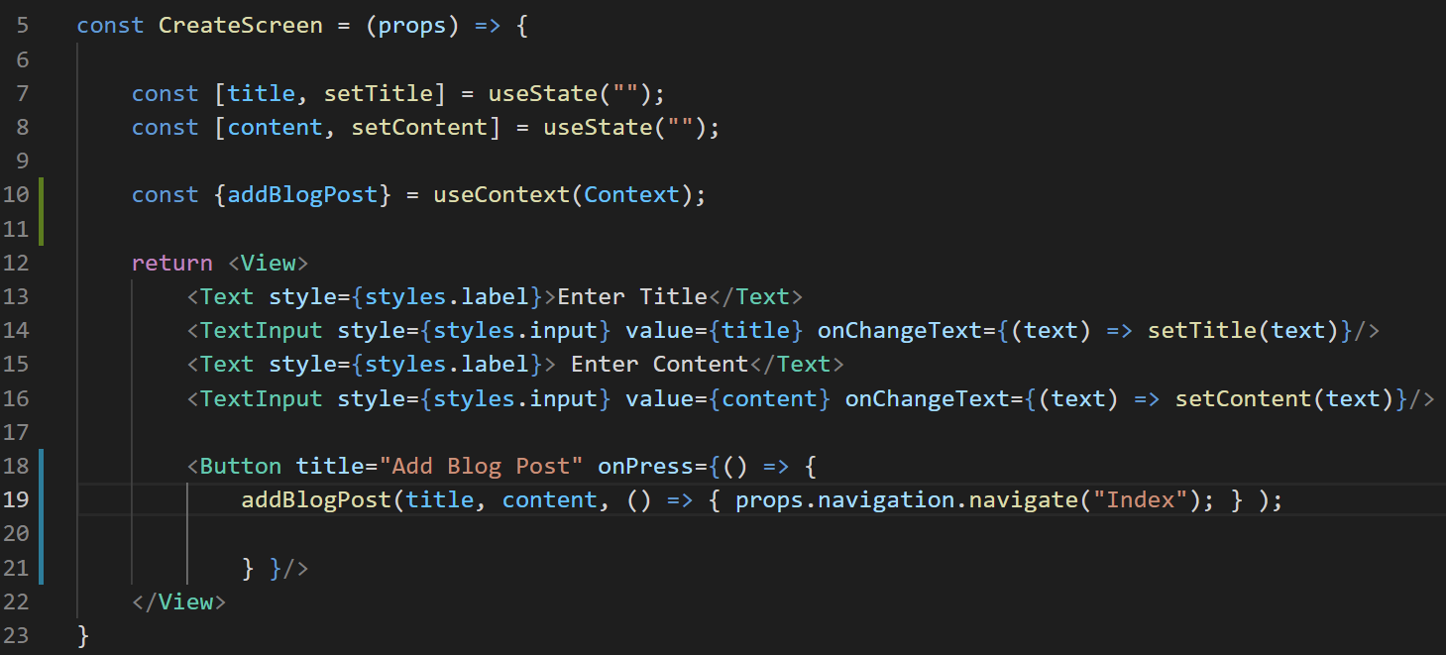
Create Screen
Just our navigation line should do fine!
Though of course, now we have to modify addBlogPost() to accept this third argument.
CreateScreen.js

Slide 29
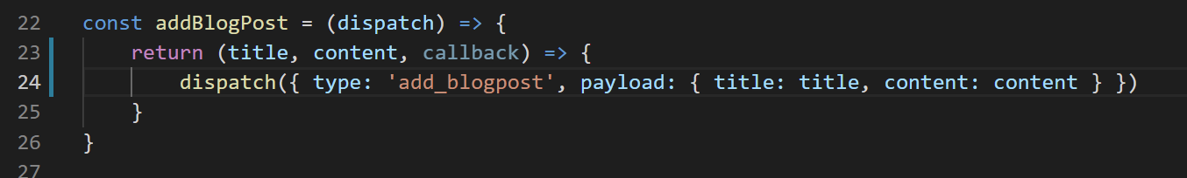
Create Screen
So, back in BlogContext…
We can change its parameter list to expect a third argument easily enough.
I’ve done that for us already.
BUT – how to use it?
BlogContext.js

Slide 30
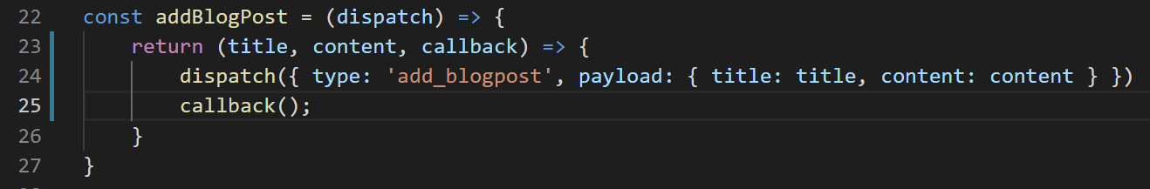
Create Screen
Well, we would just call it!
And again – for THIS application, this change doesn’t really make a difference.
BUT – imagine that instead of “dispatch” we were saving this data on a server somewhere.
BlogContext.js

Slide 31
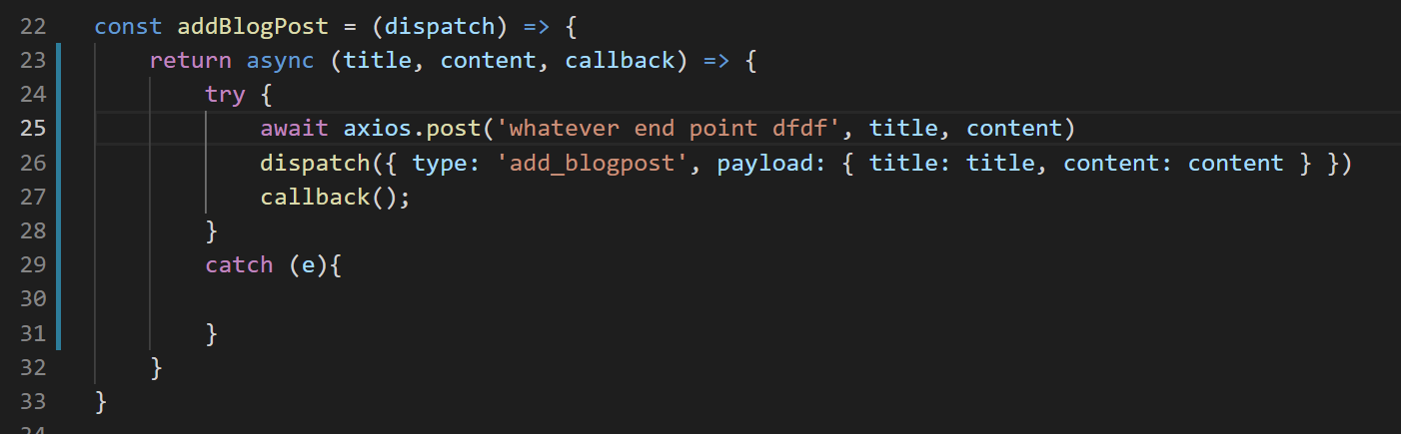
Create Screen
It might look like this!
We make our function async
We have an await when we make our network request, where we save the content or whatever…
And THEN we call the callback (here, navigate back to the index list), ONLY AFTER the network request was successful.
Again: not what we need for *this* app, but something we can work towards moving forward!
BlogContext.js

Slide 32
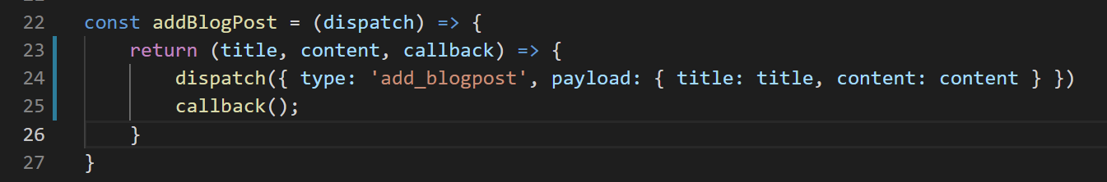
Create Screen
But again, that’s not something we actually need for right now.
This right here is very nice.
We’ll invoke callback (i.e., navigate) after our dispatch).
BlogContext.js

Slide 33
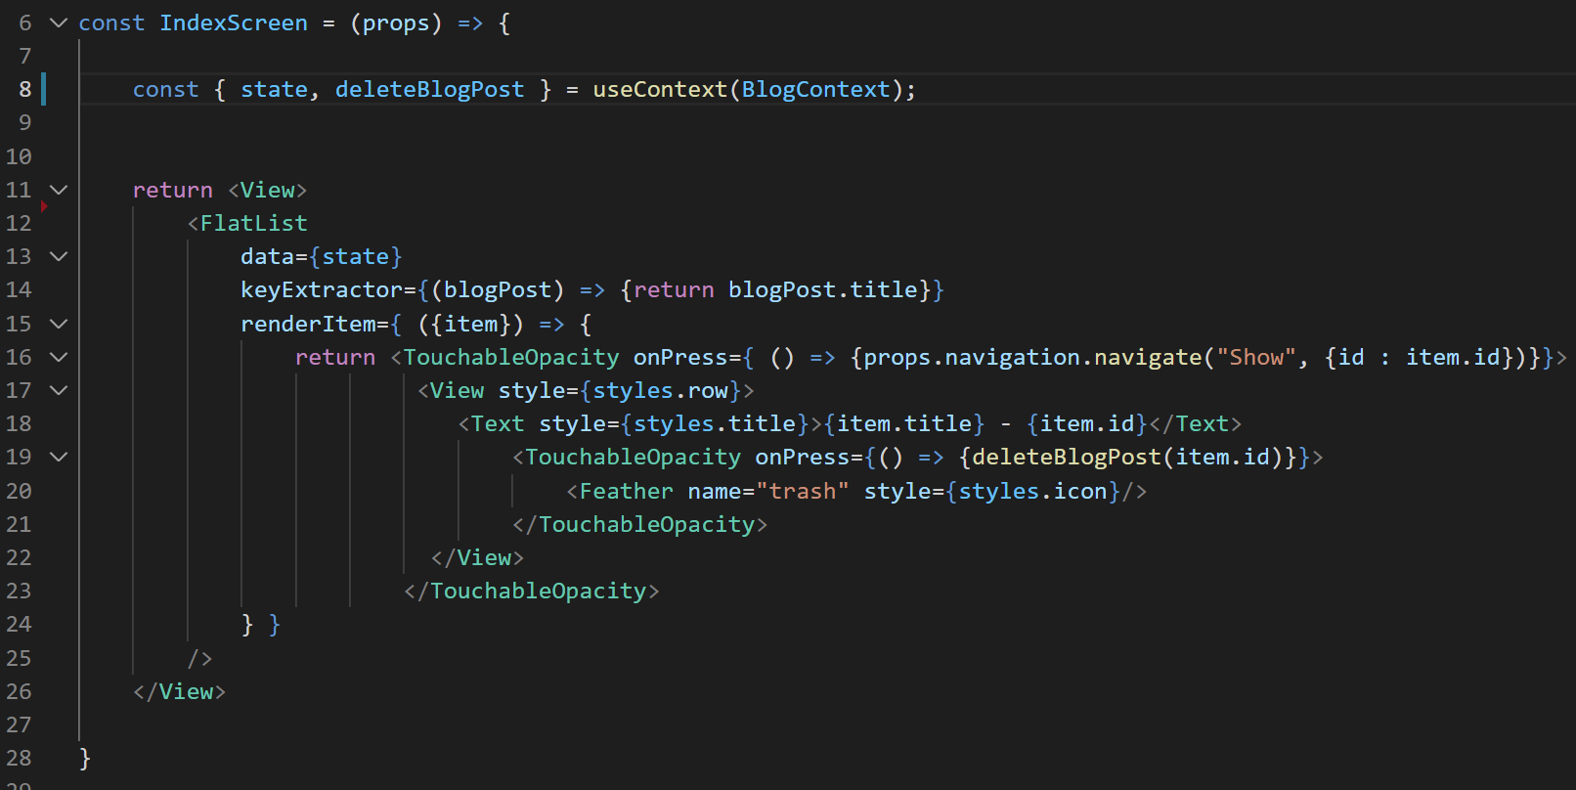

Create Screen
Also, on the subject of adding blog posts…
This “Add Post” button is now vestigial.
We can get rid of that button in IndexScreen.js
IndexScreen.js

Slide 34

Create Screen
We also can safely get rid of the line destructuring addBlogPost, since we’re not using it here anymore either.
We still need state and deleteBlogPost though!
IndexScreen.js

Slide 35

Create Screen
We also can safely get rid of the line destructuring addBlogPost, since we’re not using it here anymore either.
We still need state and deleteBlogPost though!
IndexScreen.js

Slide 36
Create Screen
OK, moving right along!
At this point, kind of the only screen that is left is the Edit screen!
Index
Show
Create
Edit
Blog List
+
Blog List
Blog List
Blog List
Blog Title
Blog Title
My blog post today is going to be about my favorite things. Rain drops on roses and whiskers on Kittens!
Enter Title:
Enter New Title:
Blog Title
Blog Title
Enter Content:
Enter New Content:
Blog Title
Save
Save

Slide 37
Today’s Agenda
Working with the Create Screen
Working with the Edit Screen
Extracting Out Form Logic
Finishing Touches

Slide 38
Edit Screen
Here’s the game plan for the edit screen.
Index
Show
Create
Edit
Blog List
+
Blog List
Blog List
Blog List
Blog Title
Blog Title
My blog post today is going to be about my favorite things. Rain drops on roses and whiskers on Kittens!
Enter Title:
Enter New Title:
Blog Title
Blog Title
Enter Content:
Enter New Content:
Blog Title
Save
Save

Slide 39


Edit Screen
First: how do we get there?
We’ll get there by clicking on the “pencil” in the show screen
Index
Show
Create
Edit
Blog List
+
Blog List
Blog List
Blog List
Blog Title
Blog Title
My blog post today is going to be about my favorite things. Rain drops on roses and whiskers on Kittens!
Enter Title:
Enter New Title:
Blog Title
Blog Title
Enter Content:
Enter New Content:
Blog Title
Save
Save

Slide 40


Edit Screen
Doing that should pre-populate the Edit screen with the title and content of the specific post we edited.
Index
Show
Create
Edit
Blog List
+
Blog List
Blog List
Blog List
Blog Title
Blog Title
My blog post today is going to be about my favorite things. Rain drops on roses and whiskers on Kittens!
Enter Title:
Enter New Title:
Blog Title
Blog Title
Blog Title
Enter Content:
Enter New Content:
Blog Title
My blog post today is…
Save
Save

Slide 41

Edit Screen
And then hitting save should update the content.
And maybe navigate us back to Index or Show.
Index
Show
Create
Edit
Blog List
+
Blog List
Blog List
Blog List
Blog Title
Blog Title
My blog post today is going to be about my favorite things. Rain drops on roses and whiskers on Kittens!
Enter Title:
Enter New Title:
Blog Title
Blog Title
Blog Title
Enter Content:
Enter New Content:
Blog Title
My blog post today is…
Save
Save

Slide 42

Edit Screen
We can get started by handling the pencil icon!
Very similar to the “plus” icon we did before!
Index
Show
Create
Edit
Blog List
+
Blog List
Blog List
Blog List
Blog Title
Blog Title
My blog post today is going to be about my favorite things. Rain drops on roses and whiskers on Kittens!
Enter Title:
Enter New Title:
Blog Title
Blog Title
Blog Title
Enter Content:
Enter New Content:
Blog Title
My blog post today is…
Save
Save

Slide 43

Edit Screen
We can get started by handling the pencil icon!
Very similar to the “plus” icon we did before!
Index
Show
Create
Edit
Blog List
+
Blog List
Blog List
Blog List
Blog Title
Blog Title
My blog post today is going to be about my favorite things. Rain drops on roses and whiskers on Kittens!
Enter Title:
Enter New Title:
Blog Title
Blog Title
Blog Title
Enter Content:
Enter New Content:
Blog Title
My blog post today is…
Save
Save

Slide 44
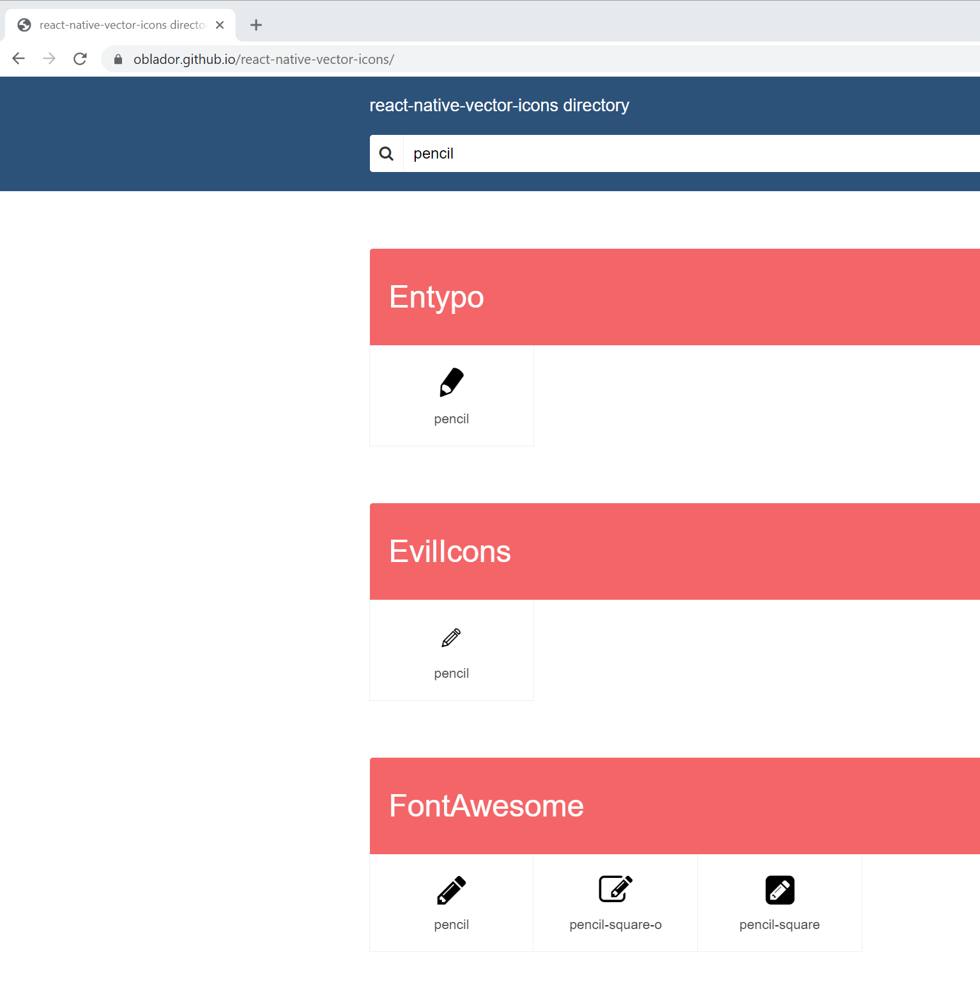

Edit Screen
So once again, you can go back to the vector icon library!
https://oblador.github.io/react-native-vector-icons/
You can look for “pencil” or “edit” or anything you want!
How about we use that FontAwesome pencil?

Slide 45
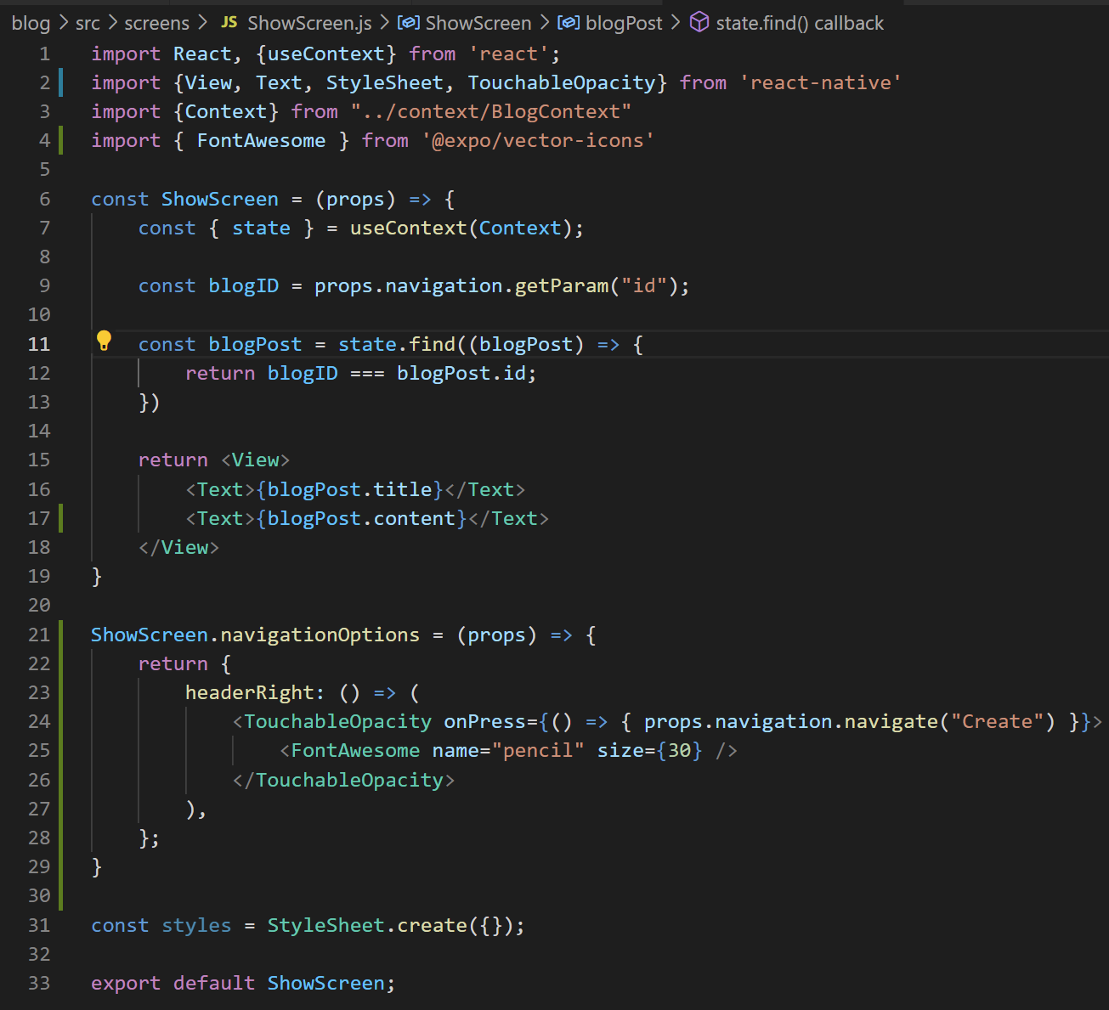
Edit Screen
And we set it up in ShowScreen in just the same way we set up the plus sign in IndexScreen.
Set up ShowScreen.navigationOptions
Have it return an object with a headerRight key.
Which itself returns some JSX.
Including TouchableOpacity
Which itself has our font.
Make sure you import TouchableOpacity here if you haven’t yet!

Slide 46
Edit Screen
Of course, we don’t want it to go to the Create screen, we want it to take us to the Edit screen.
But we’ll have to actually make that ourselves, first!

Slide 47
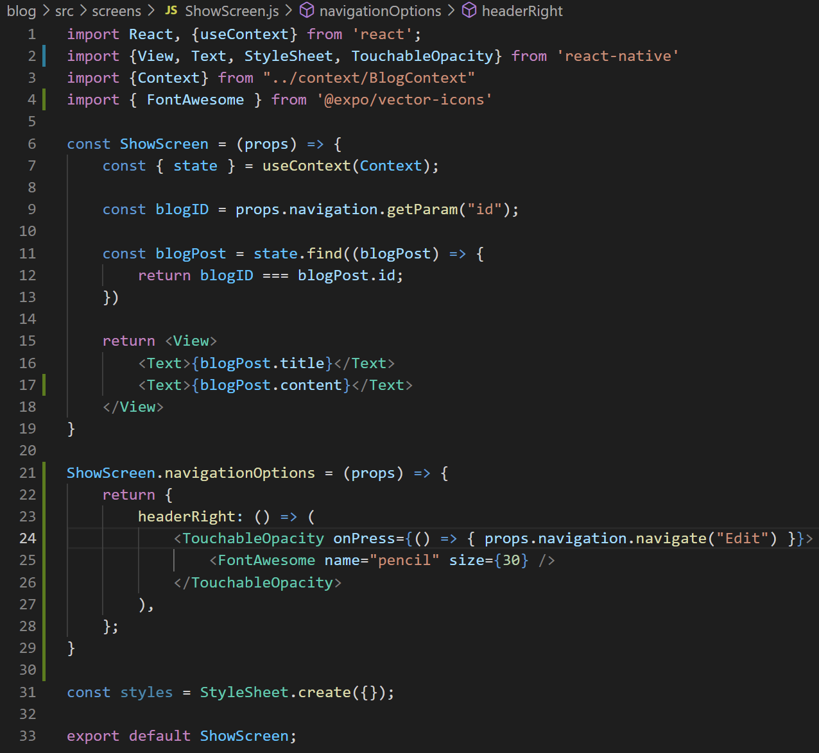
Edit Screen
But since we’re *probably* going to hook it up to our stack navigation with the route name “Edit”…
We can just make that change here real fast first

Slide 48
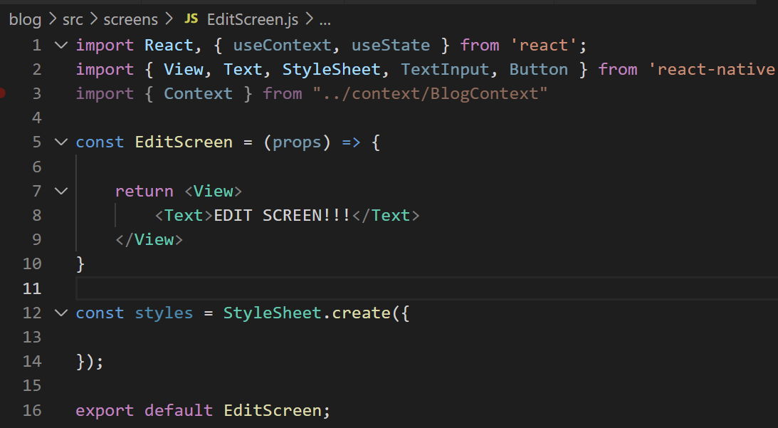
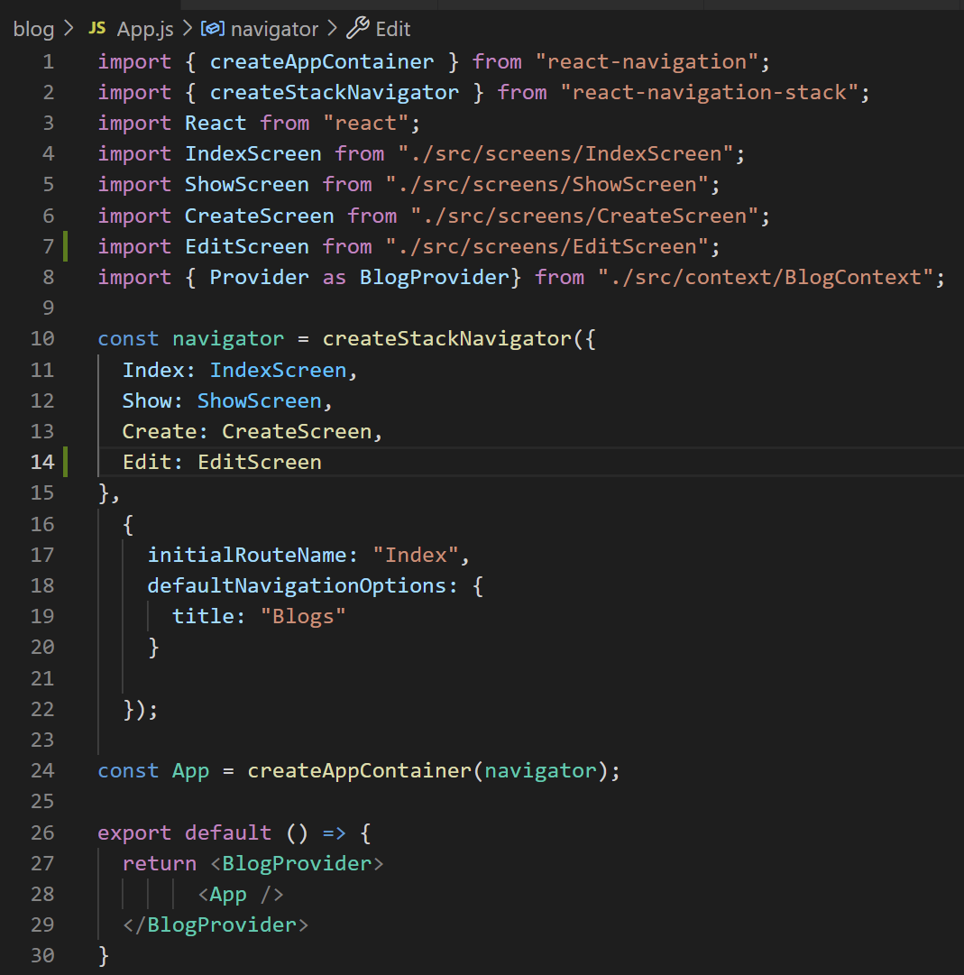
Edit Screen
And let’s just add in the boilerplate code for EditScreen, and also hook it up to App.js.
Note that I’m importing a lot of things already, since I anticipate using most of it.
EditScreen.js
App.js

Slide 49
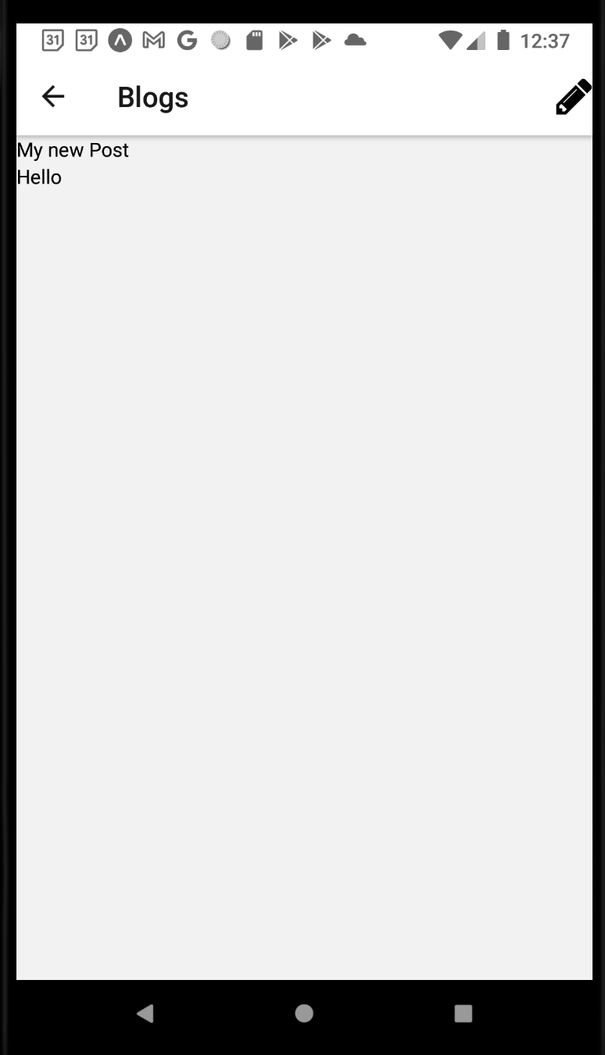
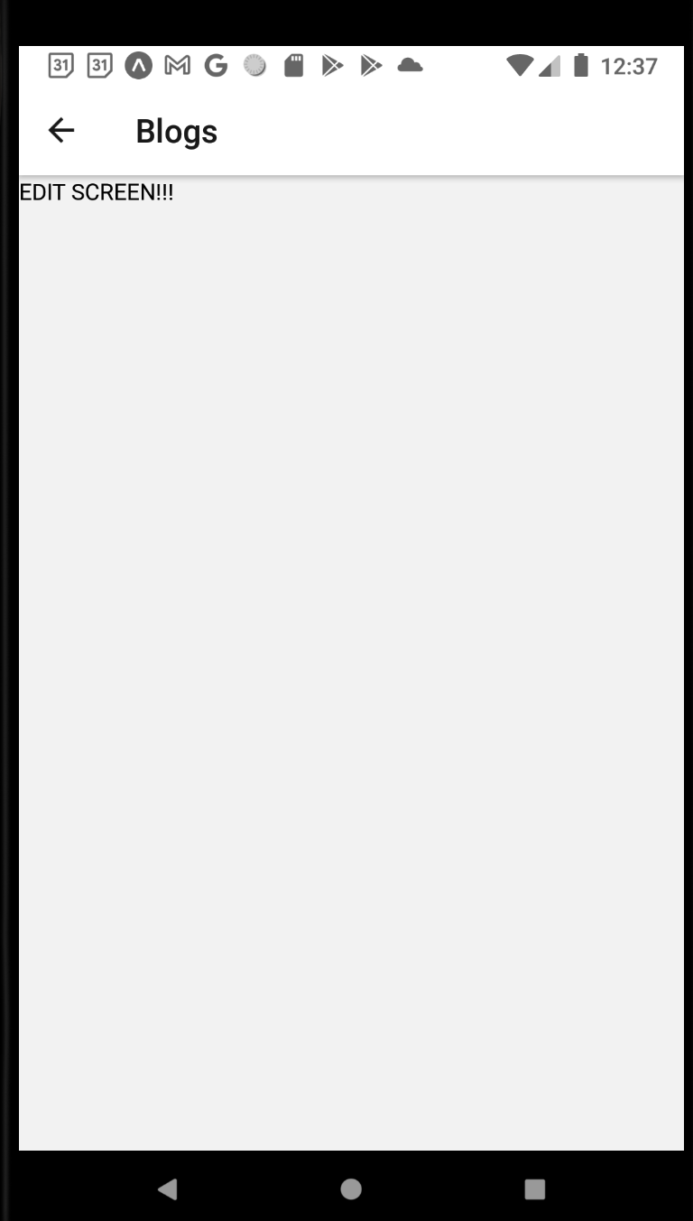


Edit Screen
And great!
Hitting the pencil now takes us to the Edit screen!

Slide 50
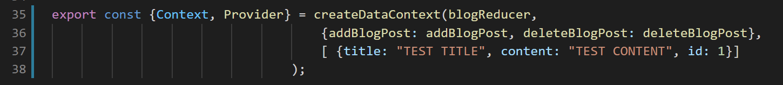
Edit Screen
One thing that will get old quickly:
As we work on this app, we keep on needing to create new blog posts.
Let’s just create a dummy “test blog post” as our initial list.
That’ll save us some time moving forward!
We do that by, instead of passing in an empty array as our initial data, we instead pass in array with a single blog object inside of it.
Now every time our app starts it’ll begin with this.

Slide 51
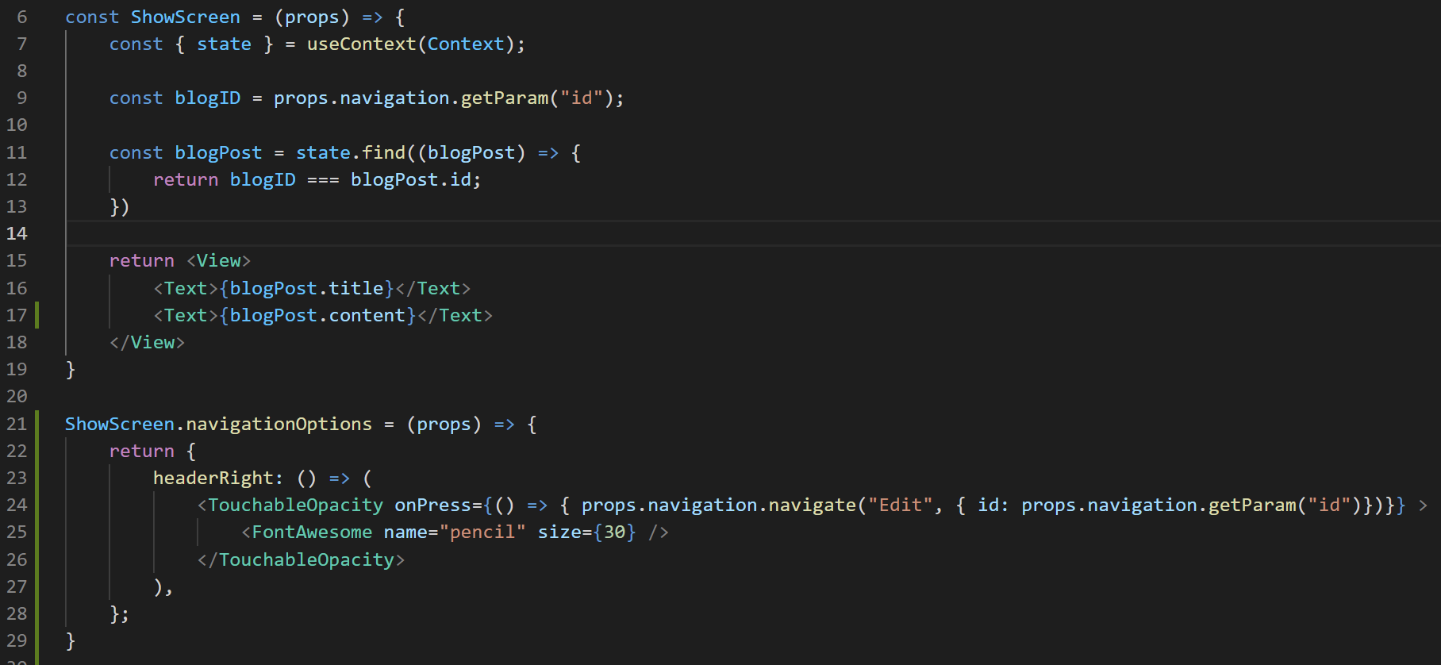
Edit Screen
Another thing to keep in mind…
Just as “ShowScreen” needed to know the id of the post to show…
EditScreen needs to know the id of the post to edit.
Thankfully, we can handle this in the same way that we’ve always done!
ShowScreen.js

Slide 52
Edit Screen
We already “get” the blogID inside of ShowScreen.js…
We can access it again in the same way when we navigate to Edit.
Note: right now blogID is outside of the scope of our navigationOptions.
That’s why we can’t just reuse it!
ShowScreen.js

Slide 53
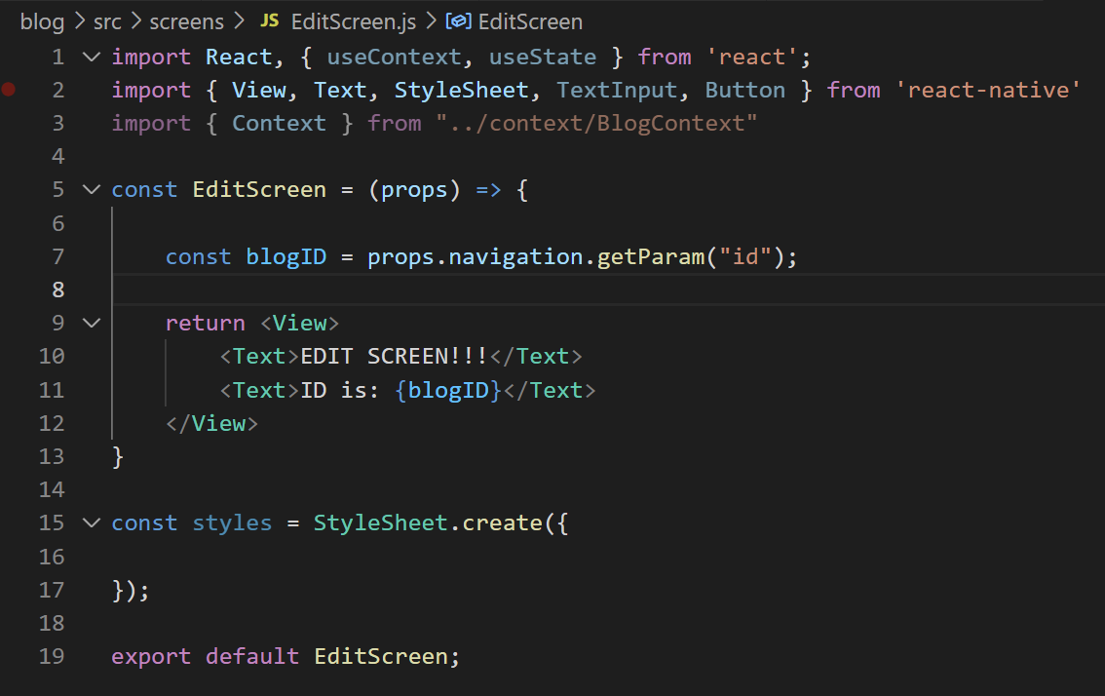
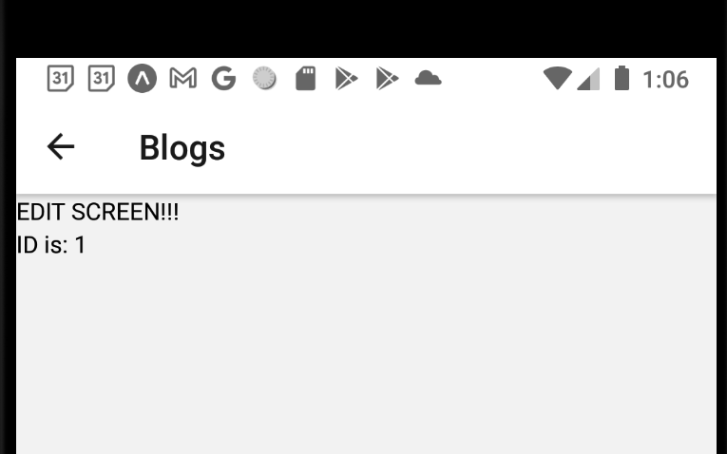
Edit Screen
And then we receive it again inside of EditScreen.
And we can test that it’s working by printing it out.
EditScreen.js

Slide 54
Edit Screen
OK!
Now we Have an EditScreen!
We have a way of navigating to it!
It knows which blog post it needs to edit!
Not too shabby!

Slide 55
Edit Screen
But we’ve got some things to do!
We need to fill it up with TextInputs and a button!
We need to pre-populate those TextInputs based on the data from the Provider!
We need to make it so that we can actually update the post when they push the button!

Slide 56

Edit Screen
The good news is that basically all of this is stuff that we’ve done several times by this point!
So, ah, take a few moments in your mind’s eye to answer the question…
How would you do this?
EditScreen.js

Slide 57
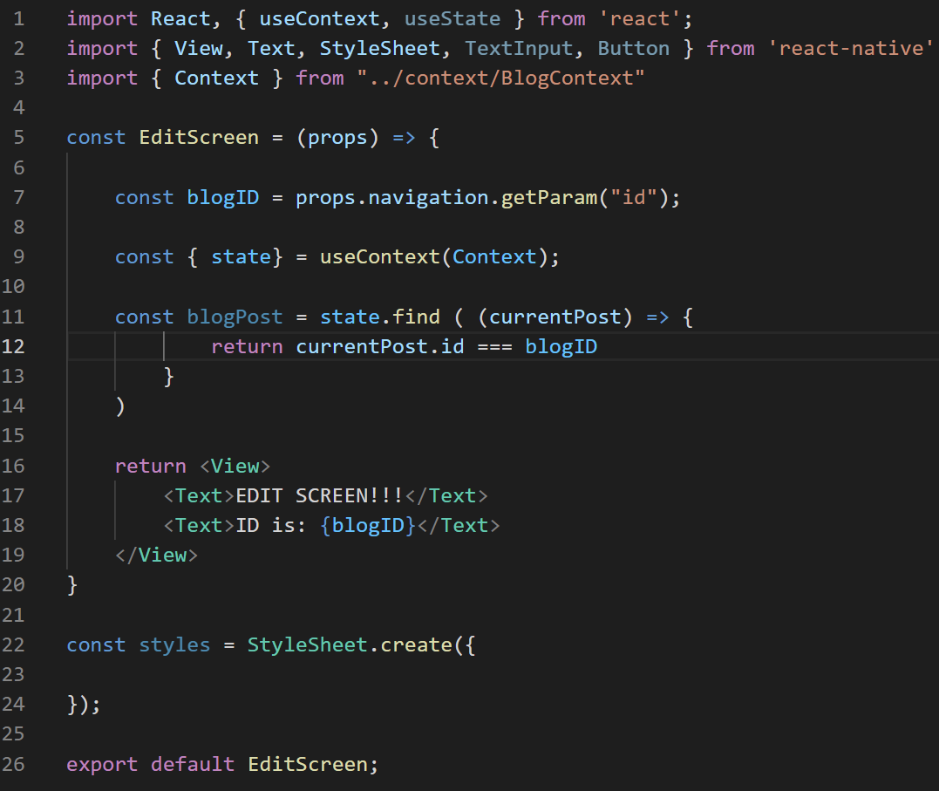
Edit Screen
The first step is to get the blog post DATA based on its id.
Again, we’ve done this exactly before!
We use the useContext hook to get the ‘state’ variable from the provider.
This is the list of ALL blog posts.
EditScreen.js

Slide 58
Edit Screen
We cycle through that array using Array.find()
It calls the provided function on every item in that array.
Storing the current item in “currentPost”
It returns the first element in the array for which that provided function returns true.
i.e., in this case, the first element whose id matches blogID
And then stores that element that it found inside of blogPost.
EditScreen.js

Slide 59

Edit Screen
In short, blogPost now is the object that we want to edit.
We’ll edit it using TextInputs…
And as we’ve seen a few times now: the way to set up TextInputs is to make the contents of their fields variables that use the react native state system.
EditScreen.js

Slide 60
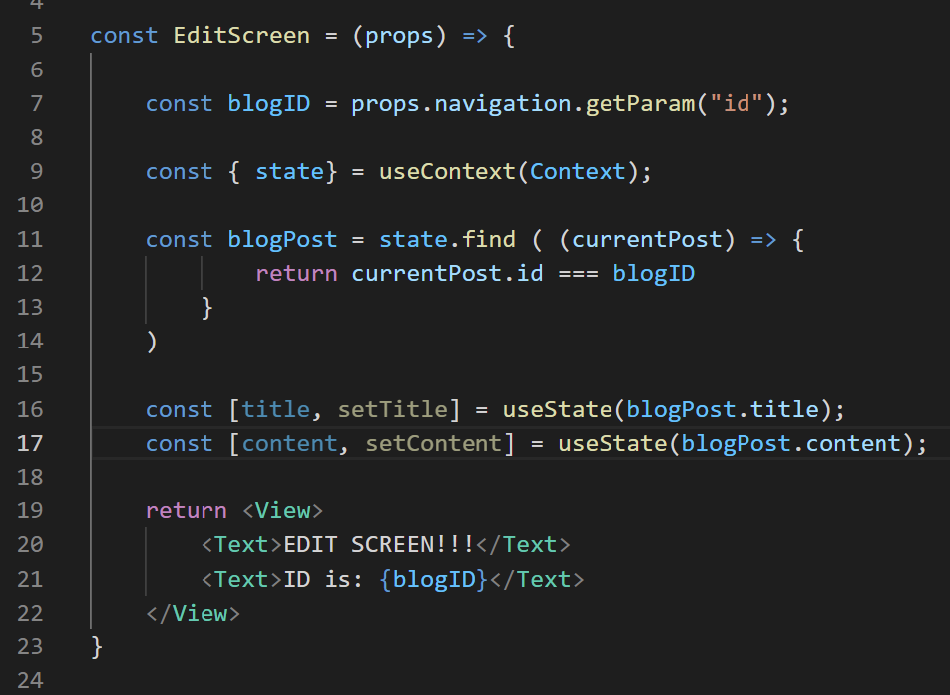

Edit Screen
So, just like this!
Note that for the initial value of these variables, we pass in blogPost.title and blogPost.content
That’s how we’ll ensure that the data is pre-populated!
EditScreen.js

Slide 61
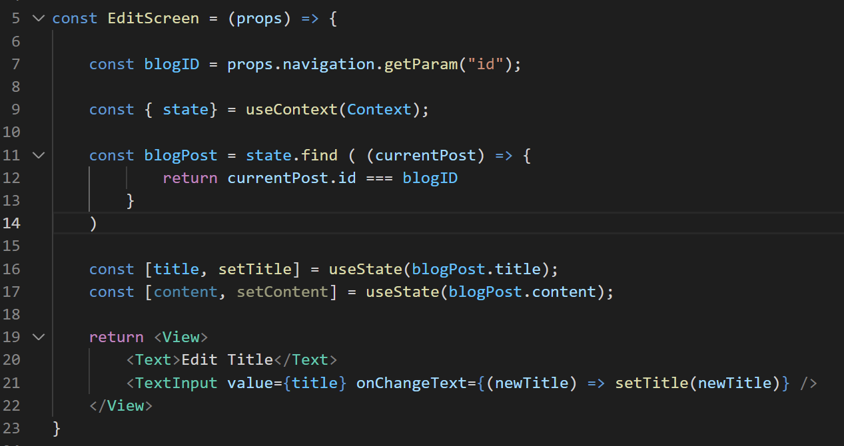
Edit Screen
And then we use them in the same way that we’ve used TextInputs before!
Just like this!
EditScreen.js

Slide 62
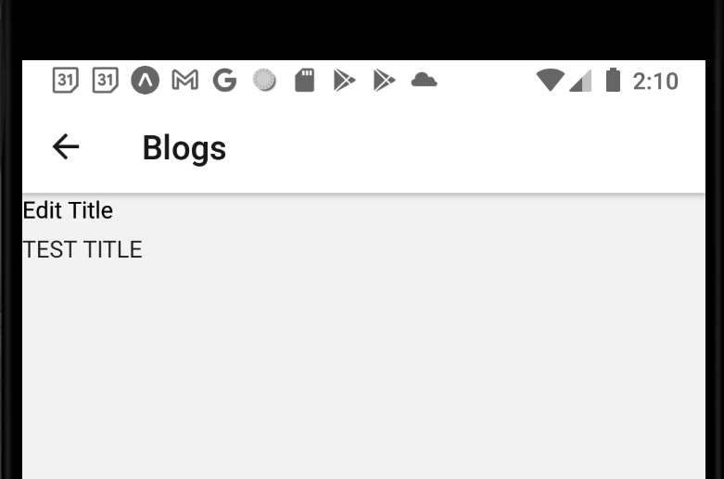
Edit Screen
Now, at this point, it’s working, and you can edit it, and it is pre-populated with the title of the original blog post.
We should be happy!
BUT… I have kind of a sinking feeling right now.
Do any of you feel it to?
What’s causing it?

Slide 63


Edit Screen
Maybe it’s the dawning realization that our Create screen and our Edit screen are VERY similar to each other.
And that it feels bad to be re-writing the same form across both screens.
Index
Show
Create
Edit
Blog List
+
Blog List
Blog List
Blog List
Blog Title
Blog Title
My blog post today is going to be about my favorite things. Rain drops on roses and whiskers on Kittens!
Enter Title:
Enter New Title:
Blog Title
Blog Title
Enter Content:
Enter New Content:
Blog Title
Save
Save

Slide 64
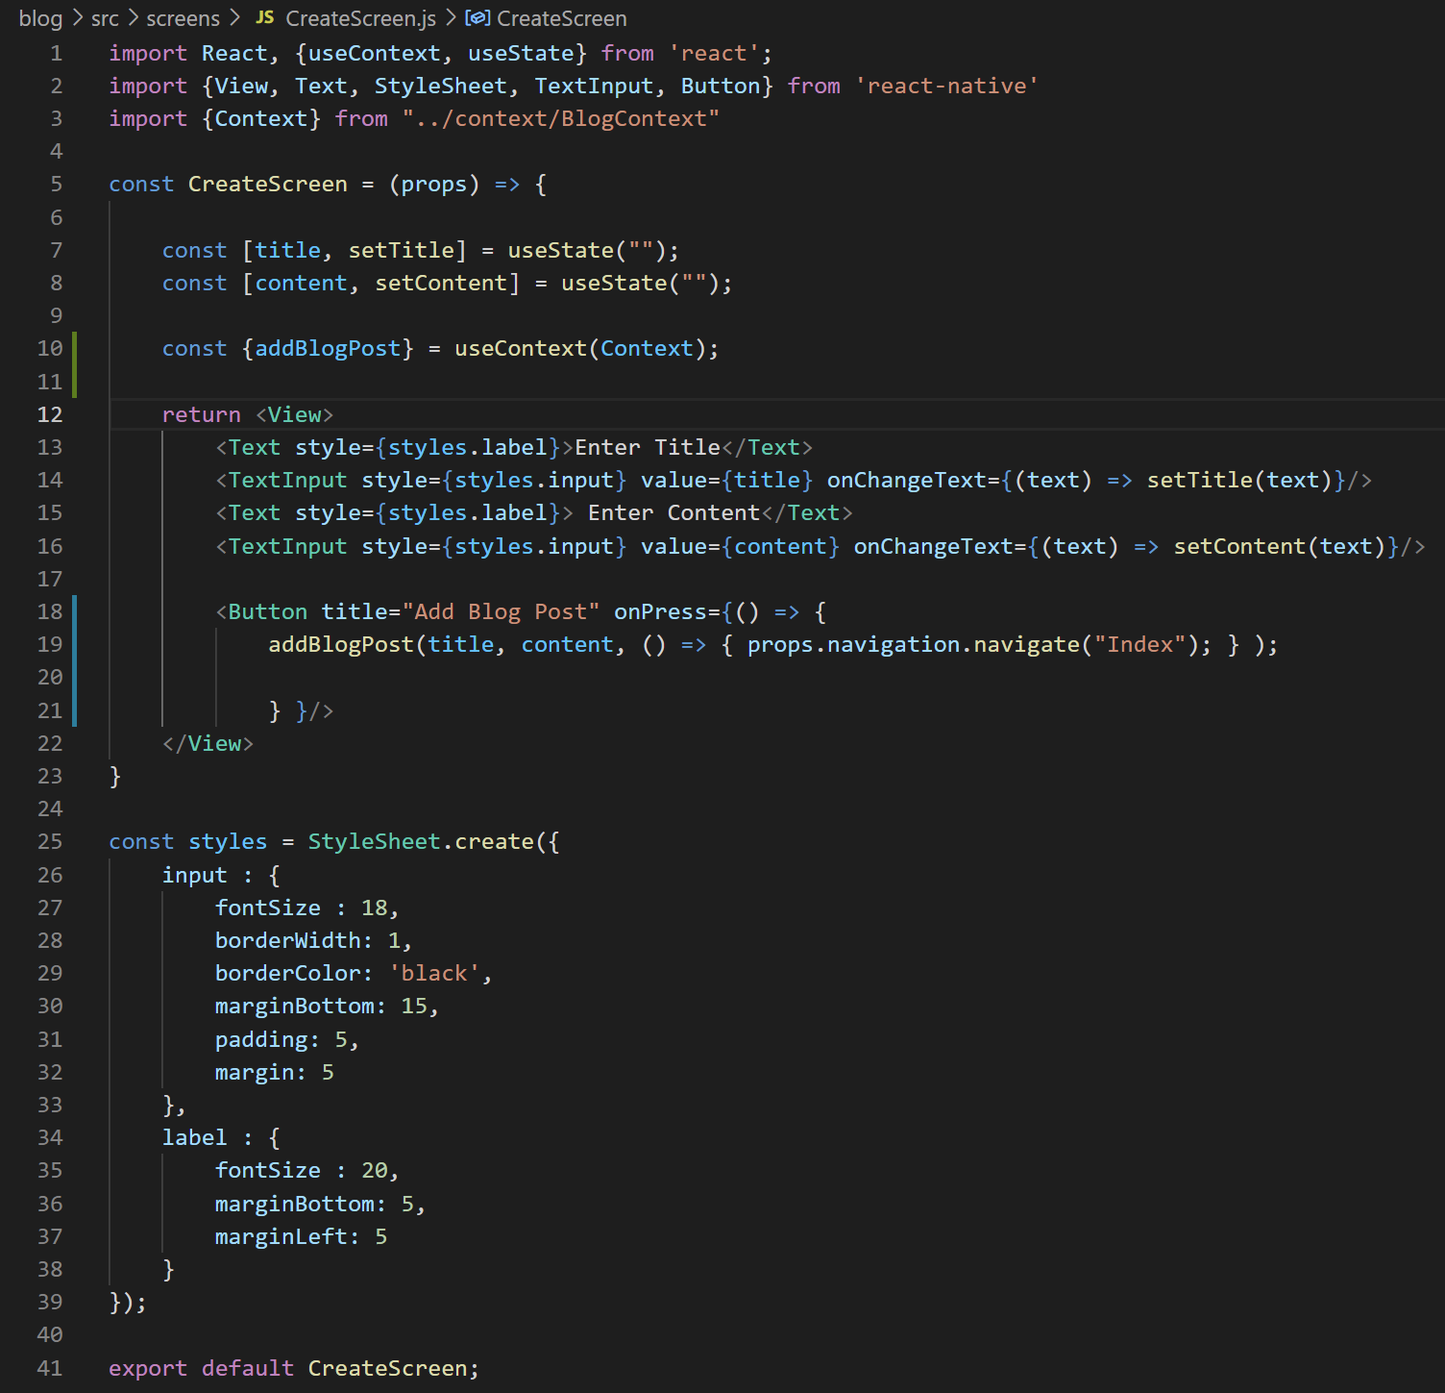
Edit Screen
SO! Let’s not do that!
Let’s take a look at CreateScreen.js
And see if we can abstract out the form content into a reusable component.
So that we can use it in both CreateScreen and EditScreen.

Slide 65
Today’s Agenda
Working with the Create Screen
Working with the Edit Screen
Extracting Out Form Logic
Finishing Touches

Slide 66
Extracting Form Logic
So, as we look at CreateScreen and the form we have, we can take a moment to think about what is “universal” and what is not.
i.e., the stuff that we always want to look the same for all uses of the form.
And the stuff that will be different from instance to instance.

Slide 67
Extracting Form Logic
Just as a first sanity pass…
Probably the style sheet will always be the same…
And the fact that we have TextInput and Text and Button components will be the same to.

Slide 68
Extracting Form Logic
But some of the specifics of the component will change.
e.g., “Enter Title” vs “Edit Title”
e.g., “Enter Content” vs “Edit Content”
e.g., When we push the button, we won’t want to add a new blog post, but rather edit an existing one.

Slide 69
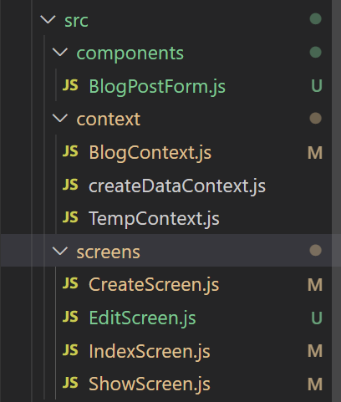

Extracting Form Logic
OK. With that high-level check out of the way… Let’s make a new folder for components inside our src directory…
And create a BlogPostForm.js inside of it.
This will be our reusable component for the form.

Slide 70
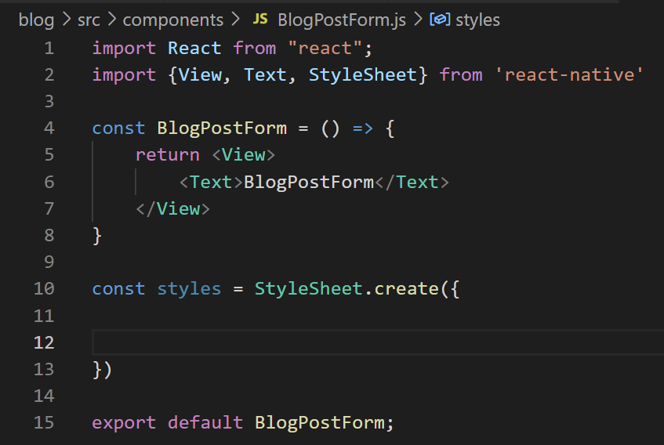
Extracting Form Logic
And we are wont to do, let’s add the boilerplate code to that new file.
Although we also are going to be cutting and pasting some stuff in here pretty quickly.
Before we do, let’s further confirm what the differences need to be between the two screens.

Slide 71
Extracting Form Logic
So, definitely we have the Create screen and the Edit screen, and they both will want to display our BlogPostForm component.
Create
Edit
BlogPostForm

Slide 72
Extracting Form Logic
But there’s a few differences between them!
Create
Edit
onSubmit
onSubmit
initial form values
initial form values
Input Labels
Input Labels
BlogPostForm

Slide 73
Extracting Form Logic
One difference is what function should get called when the button is pressed!
Create needs to create a new blog post
Edit needs to edit an existing blog post.
Create
Edit
onSubmit
onSubmit
initial form values
initial form values
Input Labels
Input Labels
BlogPostForm

Slide 74
Extracting Form Logic
A second difference is what the ‘default’ starting values should be.
Create should probably start off as “empty”, i.e., the empty string.
Edit should start off with the content of the blog post that we are editing.
Create
Edit
onSubmit
onSubmit
initial form values
initial form values
Input Labels
Input Labels
BlogPostForm

Slide 75
Extracting Form Logic
And then finally, the labels by the TextInput fields.
Maybe for Create, we want it to say “Enter Title / Enter Content”
And for Edit, we want it to say “Edit Title / Edit Content”
Create
Edit
onSubmit
onSubmit
initial form values
initial form values
Input Labels
Input Labels
BlogPostForm

Slide 76
Extracting Form Logic
With that said: I’m actually *not* going to do this last bit in the interest of time.
We’ll just have it say “enter title / content” for both screens. But this is the kind of thing that in real life you may very well want to change!
Create
Edit
onSubmit
onSubmit
initial form values
initial form values
Input Labels
Input Labels
BlogPostForm

Slide 77
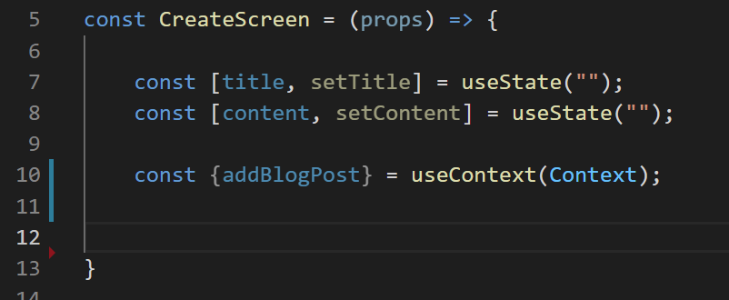
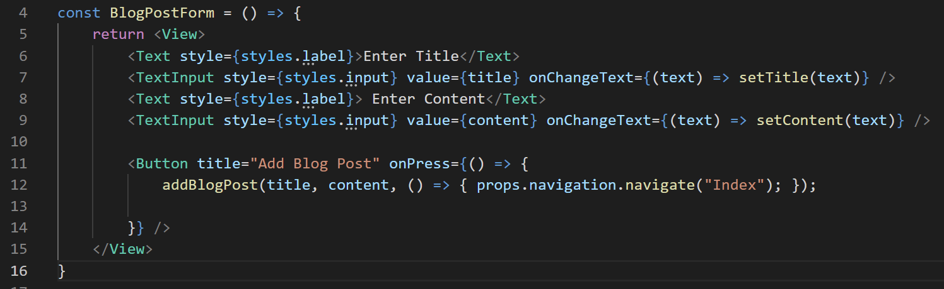
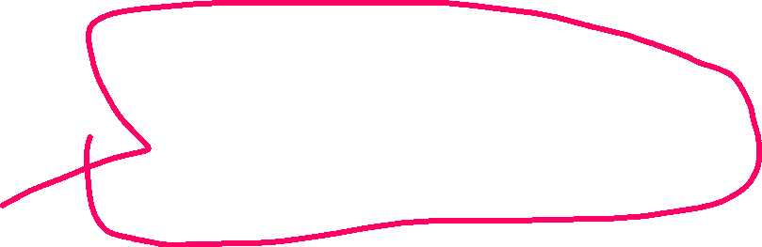


Extracting Form Logic
The first thing: let’s cut all of the form JSX out of CreateScreen, and put it into our reusable component.
CreateScreen.js
BlogPostForm.js

Slide 78
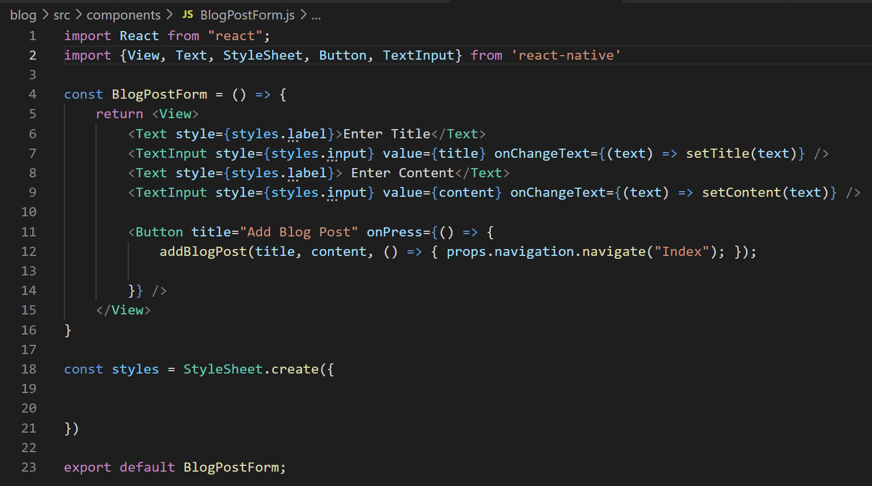
Extracting Form Logic
Then, you know, make sure BlogPostForm is importing everything that it needs…
Text, View, TextInput, Button, StyleSheet, etc.
BlogPostForm.js

Slide 79
Extracting Form Logic
Now, all of these styles don’t exist in here anymore, yeah?
BlogPostForm.js

Slide 80
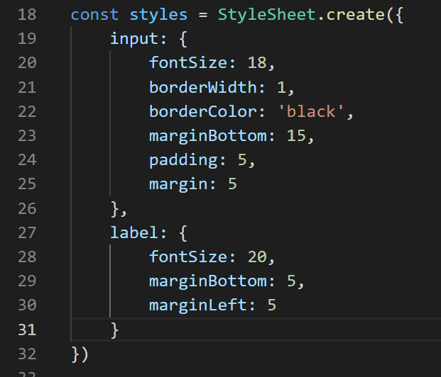
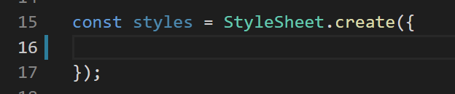
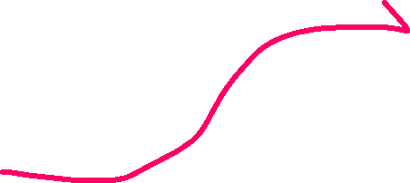


Extracting Form Logic
So again, we’ll cut all of the styles out of CreateScreen.js…
And paste them into the style sheet of BlogFormPost.js
CreateScreen.js
BlogPostForm.js

Slide 81
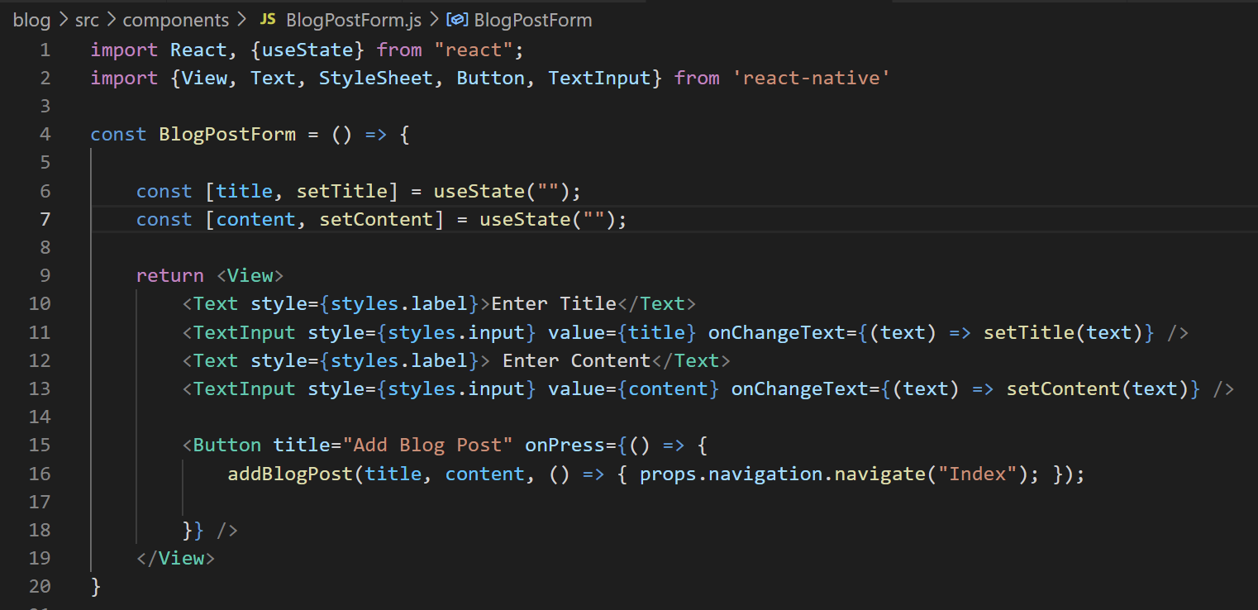
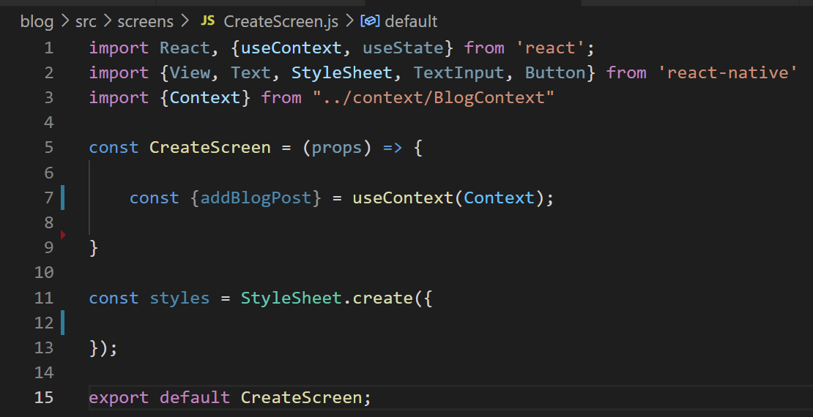


Extracting Form Logic
And finally, we’ll also cut and paste the state variables as well.
Make sure that BlogPostForm also imports useState!
CreateScreen.js
BlogPostForm.js

Slide 82
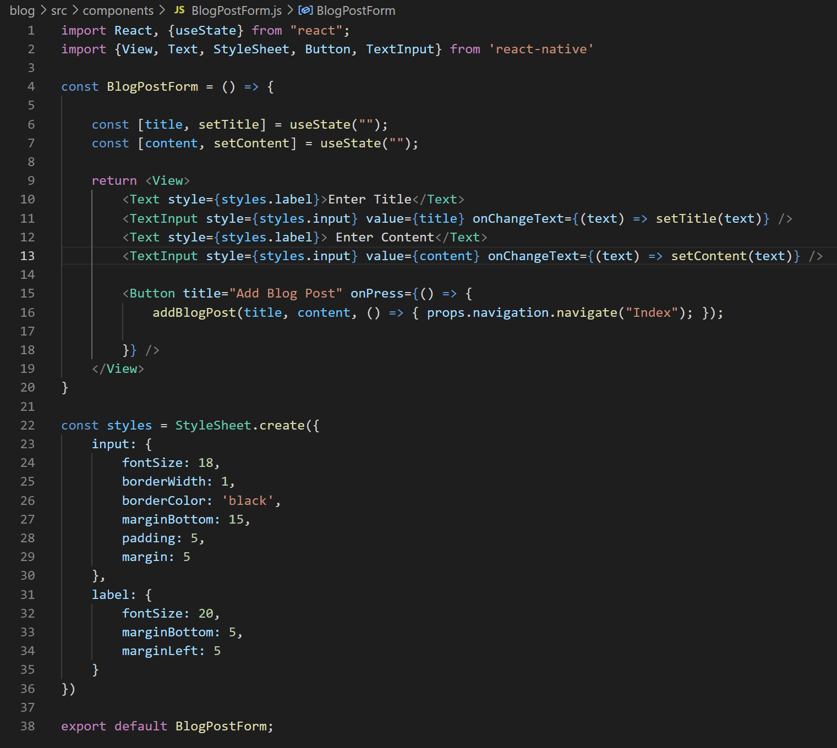
Extracting Form Logic
So our reusable component is looking pretty good!
But, ah, we can see that the Button right now always invokes addBlogPost.
That’s not what we want!
We want it to have different behavior based on what screen it is on!
BlogPostForm.js

Slide 83
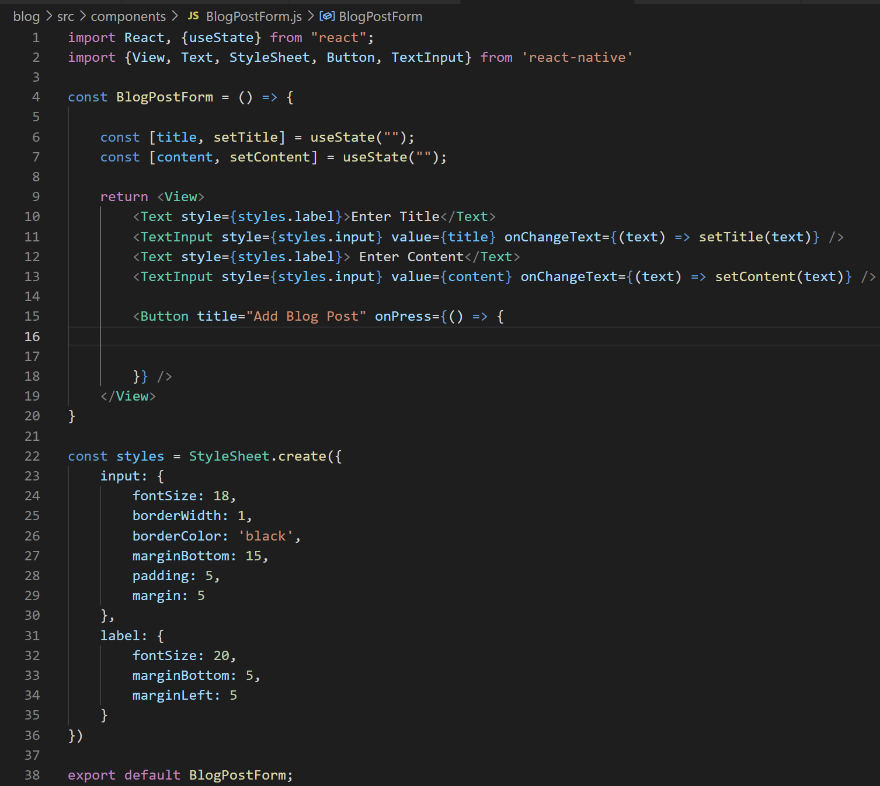
Extracting Form Logic
So for now, we can just get rid of that!
We’ll add it back in later!
And also maybe “Add Blog Post” feels *too* Add specific.
BlogPostForm.js

Slide 84


Extracting Form Logic
So we can change it to “Save” blog post!
That might feel better on both screens.
Now we have the reusable component ready, it’s time to start using it!
BlogPostForm.js

Slide 85


Extracting Form Logic
So now, back in CreateScreen.js, we can just import our new component…
And then use it!
(I also cleaned up the imports, since there’s a lot we’re not using anymore).
CreateScreen.js

Slide 86

Extracting Form Logic
We can do the same with the EditScreen!
And just like that, we are now displaying a form on two screens!
We still need to customize it of course, but at least now we’re showing the blog post form in both of our difference screens!
EditScreen.js

Slide 87


Extracting Form Logic
And indeed, both the “Create” screen and “Edit” screen now look exactly the same! They should! They use the same reusable component!
Create Blog Post
Edit Blog Post

Slide 88
Extracting Form Logic
But now let’s make sure that we’re actually passing all of this data down from the parent components down into BlogPostForm.
Create
Edit
onSubmit
onSubmit
initial form values
initial form values
BlogPostForm

Slide 89

Extracting Form Logic
So starting with CreateScreen…
We need to pass in data to the BlogPostForm via props.
Remember: we created this component, so we get to name the props anything we want.
CreateScreen.js

Slide 90
Extracting Form Logic
The first prop we’ll handle is “onSubmit”
That will be a function, that we’ll use to represent “this is what should be called when the button on the form gets pushed.
CreateScreen.js

Slide 91

Extracting Form Logic
And that will be basically exactly what we had before!
We’ll create a prop called onSubmit, and it will store a function.
CreateScreen.js

Slide 92
Extracting Form Logic
The function will take in the new title and content of the blog as arguments…
And the body of the function will invoke addBlogPost
CreateScreen.js

Slide 93
Extracting Form Logic
And remember, addBlogPost() currently takes in three arguments:
What the title should be…
What the content should be…
The callback function for “what should it do when it is done doing its work”
Which in our case is navigate back to the Index page.
CreateScreen.js

Slide 94
Extracting Form Logic
So that’s us passing the data INTO the reusable component.
Back in the reusable component itself, now we need to make use of it!
CreateScreen.js

Slide 95

Extracting Form Logic
So now, clicking on the button on our form invokes onSubmit()…
Which is a function which itself just calls addBlogPost()
BlogPostForm.js
CreateScreen.js

Slide 96
Extracting Form Logic
And at this point, it is back to “working” again.
At least the Create screen!
The EditScreen still isn’t passing any props down yet!
It needs to pass in an onSubmit prop as well!

Slide 97

Extracting Form Logic
We haven’t actually created a function to handle “edit” functionality yet in our code.
So writing a “real” onSubmit might be hard.
For now, to keep it from just being totally broken, let’s have onSubmit just call console.log().
EditScreen.js

Slide 98
Extracting Form Logic
Now, the edit screen also wants to populate those fields with the title and content of the blog!
How do we do that? Given what we have inside of EditScreen already?
EditScreen.js

Slide 99


Extracting Form Logic
The variable blogPost IS the blog we care about!
So it’s going to have a title and content property to use.
So what we can do is create a new prop that passes them down!
We can call this prop anything we want, but how about ‘initialValues’
And it’ll be an object that stores whatever initial values we need!
EditScreen.js

Slide 100

Extracting Form Logic
This is getting us closer to a true editing experience!
So now that we are passing initialValues down…
Our form can now make use of them.
Any thoughts on how to do that?
EditScreen.js
BlogPostForm.js

Slide 101

Extracting Form Logic
Like this!
We have the initial values for the title and content…
So let’s make use of them here!
However, anyone see any issues with this?
BlogPostForm.js

Slide 102
Extracting Form Logic
This works great assuming that initialValues is passed in!
But right now, we AREN’T passing it in from the Create screen.
That means props.initialValues will be undefined. Which means it would have no data!
BlogPostForm.js

Slide 103
Extracting Form Logic
In other words: at the moment, this form is ONLY going to work if we come to it from the edit screen!
Coming to it from the create screen is no good!
BlogPostForm.js

Slide 104

Extracting Form Logic
But for what its worth, we CAN INDEED see this form on the Edit screen.
And it does come pre-populated with the title and content!
You’ll just have to believe me that I didn’t type those things in myself.

Slide 105

Extracting Form Logic
But for what its worth, we *CAN’T INDEED* see this form on the Create screen.
It says “undefined is not an object”
So, yeah. We need to deal with that!

Slide 106
Extracting Form Logic
Once again: an “easy way” and a “new way”
The easy way probably has entered your heads already:
Just, like, pass down an “initialValues” object from create!
Or this alternative easy way:
Do some data validation inside of the form!
And I mean, sure, yes, that would get the job done.

Slide 107
Extracting Form Logic
But I want to introduce you to a new notion!
default props
A way that you can specify what a prop value should be in a component if it didn’t receive that prop from its parent!

Slide 108


Extracting Form Logic
We’ll set it up as another property of our component called “defaultProps”

Slide 109

Extracting Form Logic
And then we fill it in like this!
We’ll say that the default props should include an object called initialValues
Which itself should have a “title” property and “content” property, both set to the empty string.

Slide 110
Extracting Form Logic
This is all nicely automatic!
If we provide our own “initialValues” prop when creating a component, it’ll use that!
Otherwise, it’ll use what we are specifying here!

Slide 111

Extracting Form Logic
And now, happily, it is back to working again!
Hooray!

Slide 112
Today’s Agenda
Working with the Create Screen
Working with the Edit Screen
Extracting Out Form Logic
Finishing Touches

Slide 113
Finishing Touches
OK, so, nothing crashes at the moment! Excellent!
However, the edit screen doesn’t actually *do* anything.
Remember? We just gave it the placeholder of printing to the console when we push the button here.

Slide 114
Finishing Touches
What will we need to do to get it all set up and working?

Slide 115
Finishing Touches
We need to make it so that when they push the button, we modify the state!
In order to do this, we’ll need to add in a new action function!
To join the ranks of our “add” and “delete” functionality.
We’ll need to update the reducer to know what to do when this new action transpires!

Slide 116

Finishing Touches
BlogContext.js
Let’s start with the new action function. These are the ones we had before right?
And the great thing is: any new action we make it going to more or less follow this same pattern!

Slide 117

Finishing Touches
BlogContext.js
So starting like this – remember, these functions take in the ‘dispatch’ function, and their body is them returning a new, inner function, that actually calls dispatch.
So here’s a quick question: what should go in the parameter list on line 36?

Slide 118

Finishing Touches
BlogContext.js
How about the id, title, and content?
The id so we know WHICH blog post we need to edit.
And the title and content, so we know HOW we want to edit it.
And so the next question: what should the body look like on line 37?

Slide 119


Finishing Touches
BlogContext.js
Maybe something like this, huh?
We create a new ‘edit’ type, and our payload has all of the things we just passed in.

Slide 120

Extracting Form Logic
BlogContext.js
And I know you are itching to add this to the reducer...
But before you do – don’t forget: we need to add this to our createDataContext function.
This is what will ultimately add this function to our Provider, which will make it accessible throughout our whole application.

Slide 121

Finishing Touches
And so, then, back in EditScreen…
When we use the useContext hook, we’ll make sure to also grab this new action function we made…
And then in the onSubmit prop, we’ll call that function!
Passing in the appropriate values!
EditScreen.js

Slide 122


Finishing Touches
And so the final thing now is to add a new case for our reducer.
And when we fill it in, we’re going to learn about a new JavaScript function.
BlogContext.js

Slide 123

Finishing Touches
That new function is called “map”
Like “filter” and “find”, it is a function associated with Arrays.
Like filter: it ultimately creates a new array.
The idea is that the new array is full of (possibly) altered versions of the original arrays elements.
BlogContext.js

Slide 124
Finishing Touches
As before, we provide it a function that will be called on each element of the array.
We reference the current element using that ‘blogPost’ parameter here.
And that function should return how we want that element to be changed.
That new version is that added to the new array we’re constructing.
BlogContext.js

Slide 125
Finishing Touches
In THIS situation, for each element, we’ll check if its id matches the id of the post we are editing.
BlogContext.js

Slide 126
Finishing Touches
If it DOES match, then what we return is action.payload
Which in this situation, is an object with the correct id and the edited title and content
i.e., it *is* the edited blog post.
If it DOESN’T match, than we return blogPost
i.e., we do not alter the element at all.
BlogContext.js

Slide 127
Finishing Touches
At the end of the day, we are returning a new list that will have all of the old blog posts…
EXCEPT the blog post that we edited, instead of it being its original form, will instead be a blog post with this new content.
i.e., we edited the one blog post, and ONLY that blog post.
BlogContext.js

Slide 128

Finishing Touches
And that’s that!
You’ll need to take more word for it, but I edited that title!
Pretty darn cool!

Slide 129
Finishing Touches
However, just like when creating a post at first, it doesn’t automatically navigate us to a new screen when we click “save” on the edit page.
Let’s address that too!
Using, once again, a new technique!

Slide 130
Finishing Touches
We’ve been using props.navigation.navigate(ROUTE_NAME) to go to a specific page.
But remember: this is a Stack navigator!
It stores the pages we’ve visited already in a stack data structure!

Slide 131
Finishing Touches
As such, there is another function we can use instead of navigate: pop()
Just like popping the top item off of a stack…
This pops the current screen off the top of the stack!
Essentially, taking us back to the previous screen.

Slide 132

Extracting Form Logic
BlogPostForm.js
So, this is making use of it in BlogPostForm!
We’ve just added a new, fourth argument to onSubmit()
The callback function – what we want to have happen when our work is complete.
In this case: we’ll call that new pop() function, i.e., go back to the previous screen.

Slide 133

Finishing Touches
And then inside of our editBlogPost action…
we just need to tell it to now expect a fourth argument…
And then to invoke it after our dispatch is complete!
BlogContext.js

Slide 134
Finishing Touches
AND… there you have it!
That was it, that was the last step!
BlogContext.js

Slide 135

Finishing Touches
We have the ability to create new blog posts!
And when we do, we are nicely taken back to the Index page!

Slide 136

Finishing Touches
We can then read our blog posts!
They have titles and content!
Yes, formatting would be nice, but hey, we weren’t focusing on that so much here!

Slide 137

Finishing Touches
When we go to the edit screen, it populates the fields for us automatically!

Slide 138

Finishing Touches
And then when we save our edits, it nicely takes us back to the ‘show’ screen!
Where we can see our changes reflected!

Slide 139

Finishing Touches
However, if we close the app and start it up again…
We go back to nothing.
We lose all of our beautiful blog posts.

Slide 140
Finishing Touches
SO!
That’s what we will tackle next!
Next time, we’ll see how we can create a simple little data server to hold our data!
And then our app can read from it! So that work we do in one session persists into the next!
It’ll be great!

